Slide 1

Economic Update
A Closer Look at Q4 2024 Data
Released January 2025

Slide 2
Economic Update
A Closer Look at Q4 2024 Data
Released January 2025

Slide 3

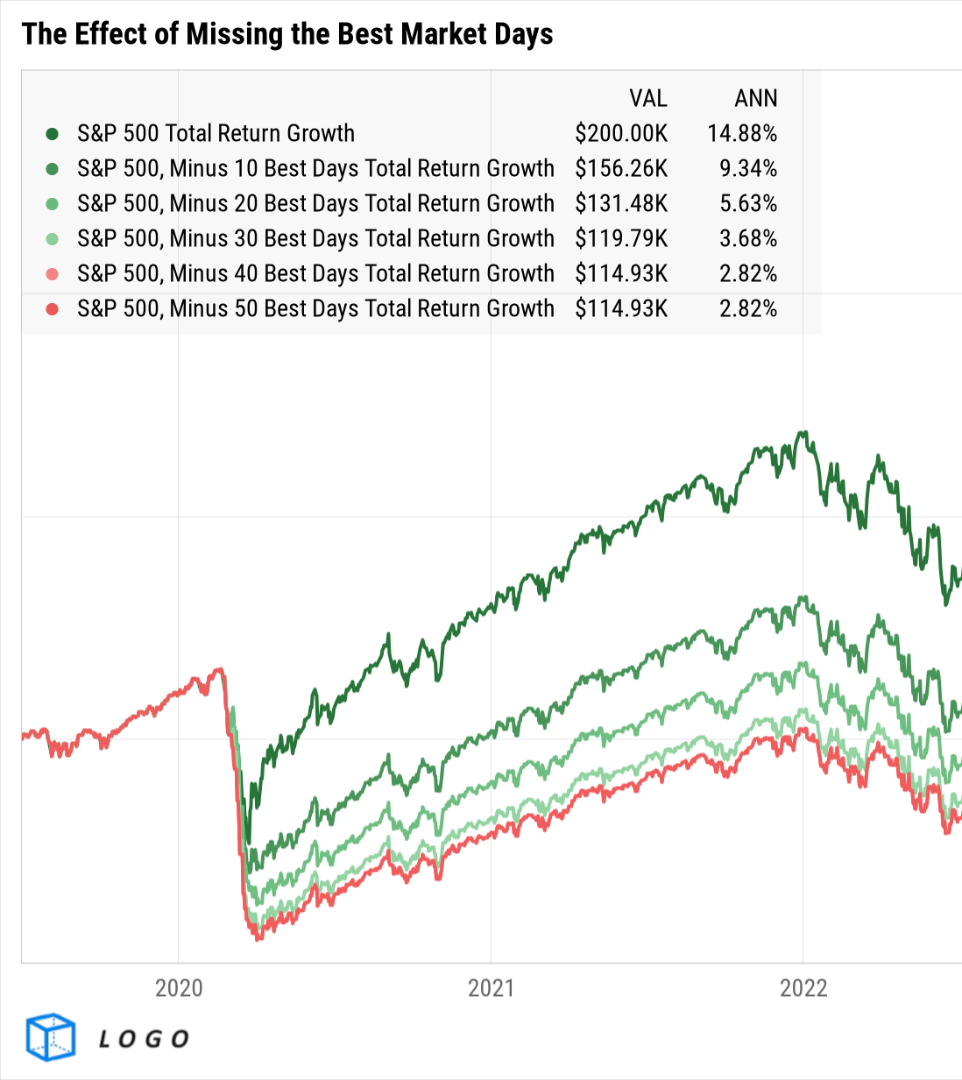




About this deck:
Use these visuals about important investing concepts in your own presentations; share with clients, prospects, colleagues, or followers online! Looking for a PDF version of this deck? Download it here.
If you’ve uploaded a logo to YCharts, all visuals in YCharts will appear with that logo.
Not yet a YCharts user? Get started today:
Start a Free Trial
Book a Demo
YCharts clients: have your
firm logo added to all charts!
Released January 2025

Slide 4


Jump to Section…
Market Data
Charts and Tables Highlighting the Performance of Stock Market Indicators and Asset Classes over the Latest Quarter
Macroeconomic Data
Leading and Lagging Economic Data and Trends from Key Economic Reports Published Recently
Bonds & Interest Rates
Collection of Data Summarizing Moves in the Fixed Income Markets over the Last Quarter
Charts of the Moment
Visuals Depicting Trends that are Impacting the Markets
and Investments
Notes:
→ Don’t forget to expand and leverage the commentary provided in the speaker notes section for more details on each slide!

Slide 5
Market Data
Charts and Tables Highlighting the Performance of Stock Market Indicators and Asset Classes over the Latest Quarter

Slide 6
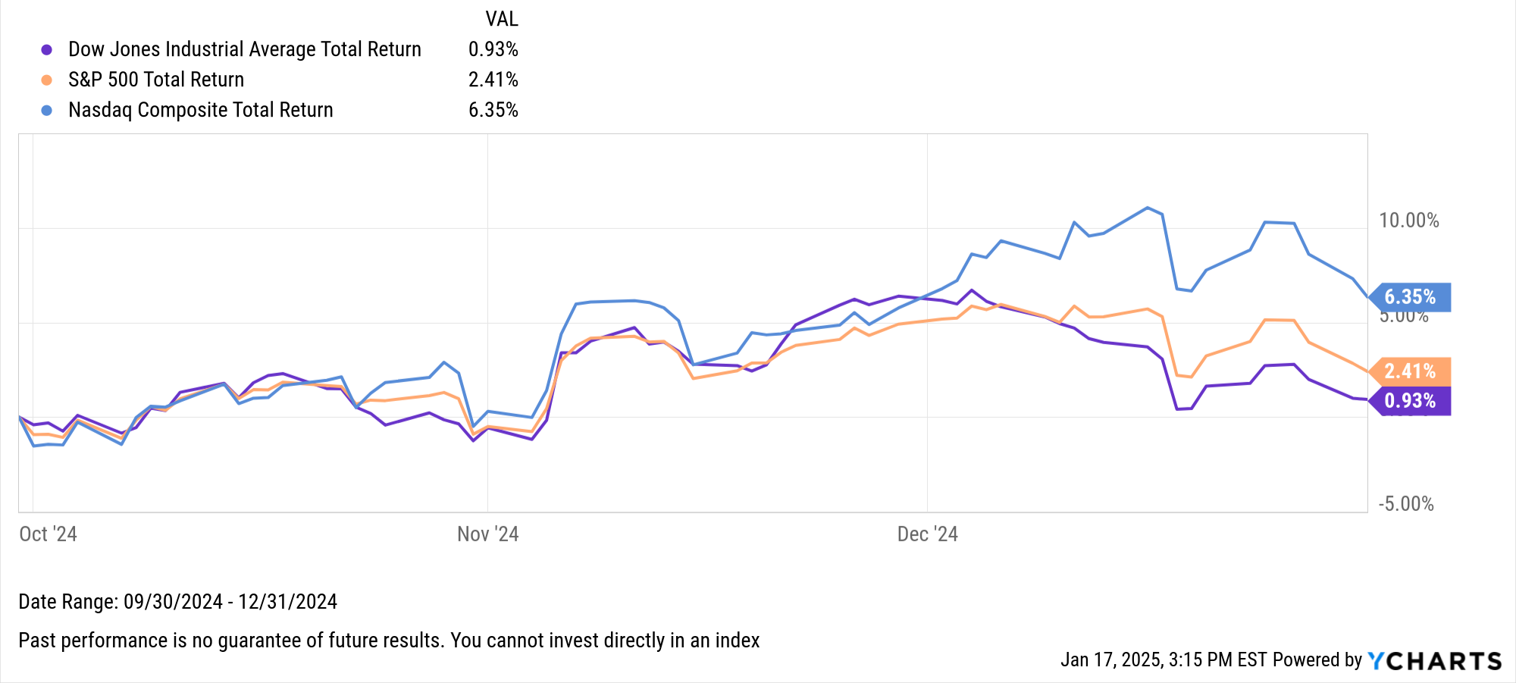

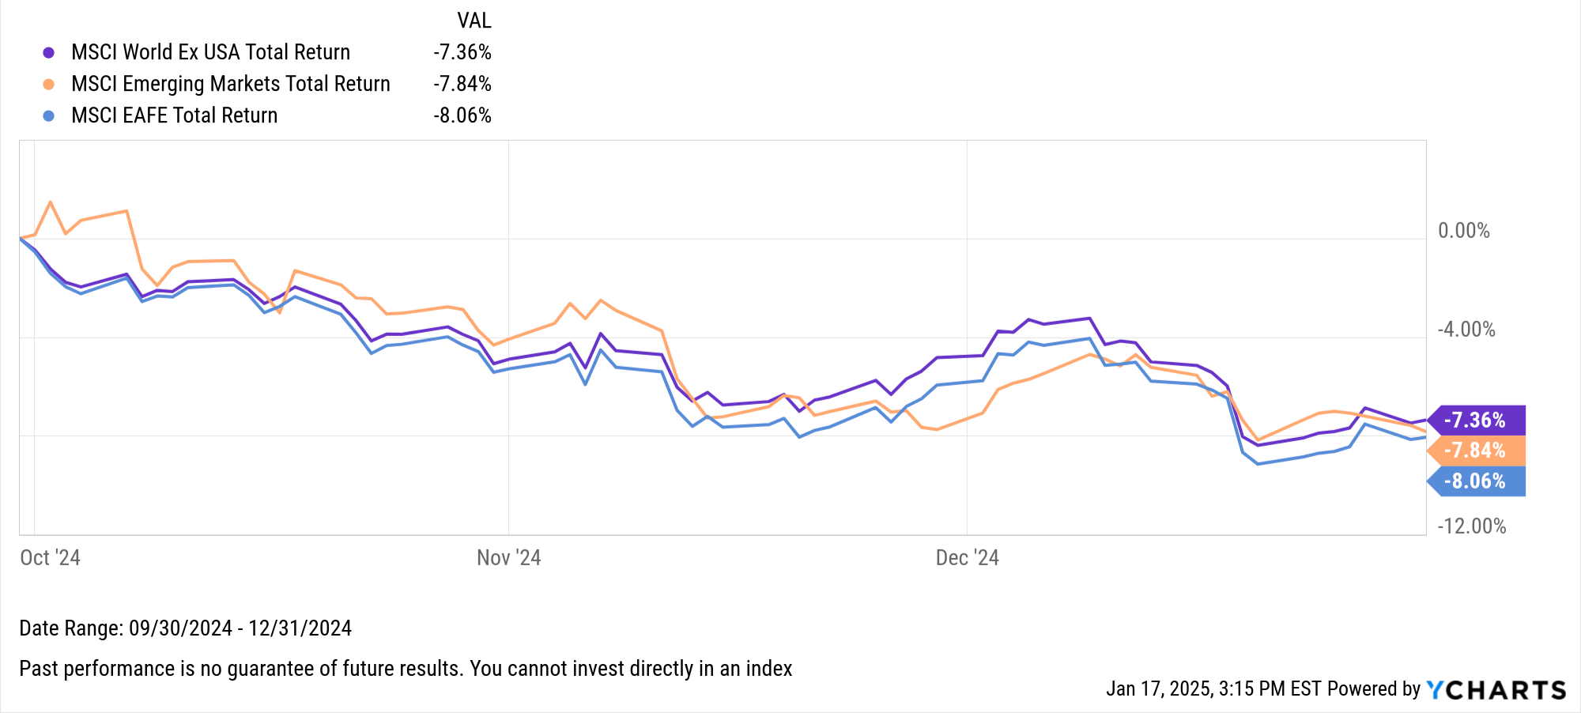
Key Stock Market Index Performance
US Markets | Q4 2024 Return
Dow Jones Industrial Average Total Return | 0.51%
S&P 500 Total Return | 2.07%
Nasdaq Composite Total Return | 6.17%
Global Markets | Q4 2024 Return
MSCI World Ex USA Total Return | -7.36%
MSCI Emerging Markets Total Return | -7.84%
MSCI EAFE Total Return | -8.06%
Notes:
Index Total Returns for Q4 2024:
US Indices:
Dow Jones Industrial Average Total Return: +0.51%
S&P 500 Total Return: +2.07%
Nasdaq Composite Total Return: +6.17%
Global Indices:
MSCI World Ex USA Total Return: -7.36%
MSCI Emerging Markets Total Return: -7.84%
MSCI EAFE Total Return: -8.06%

Slide 7
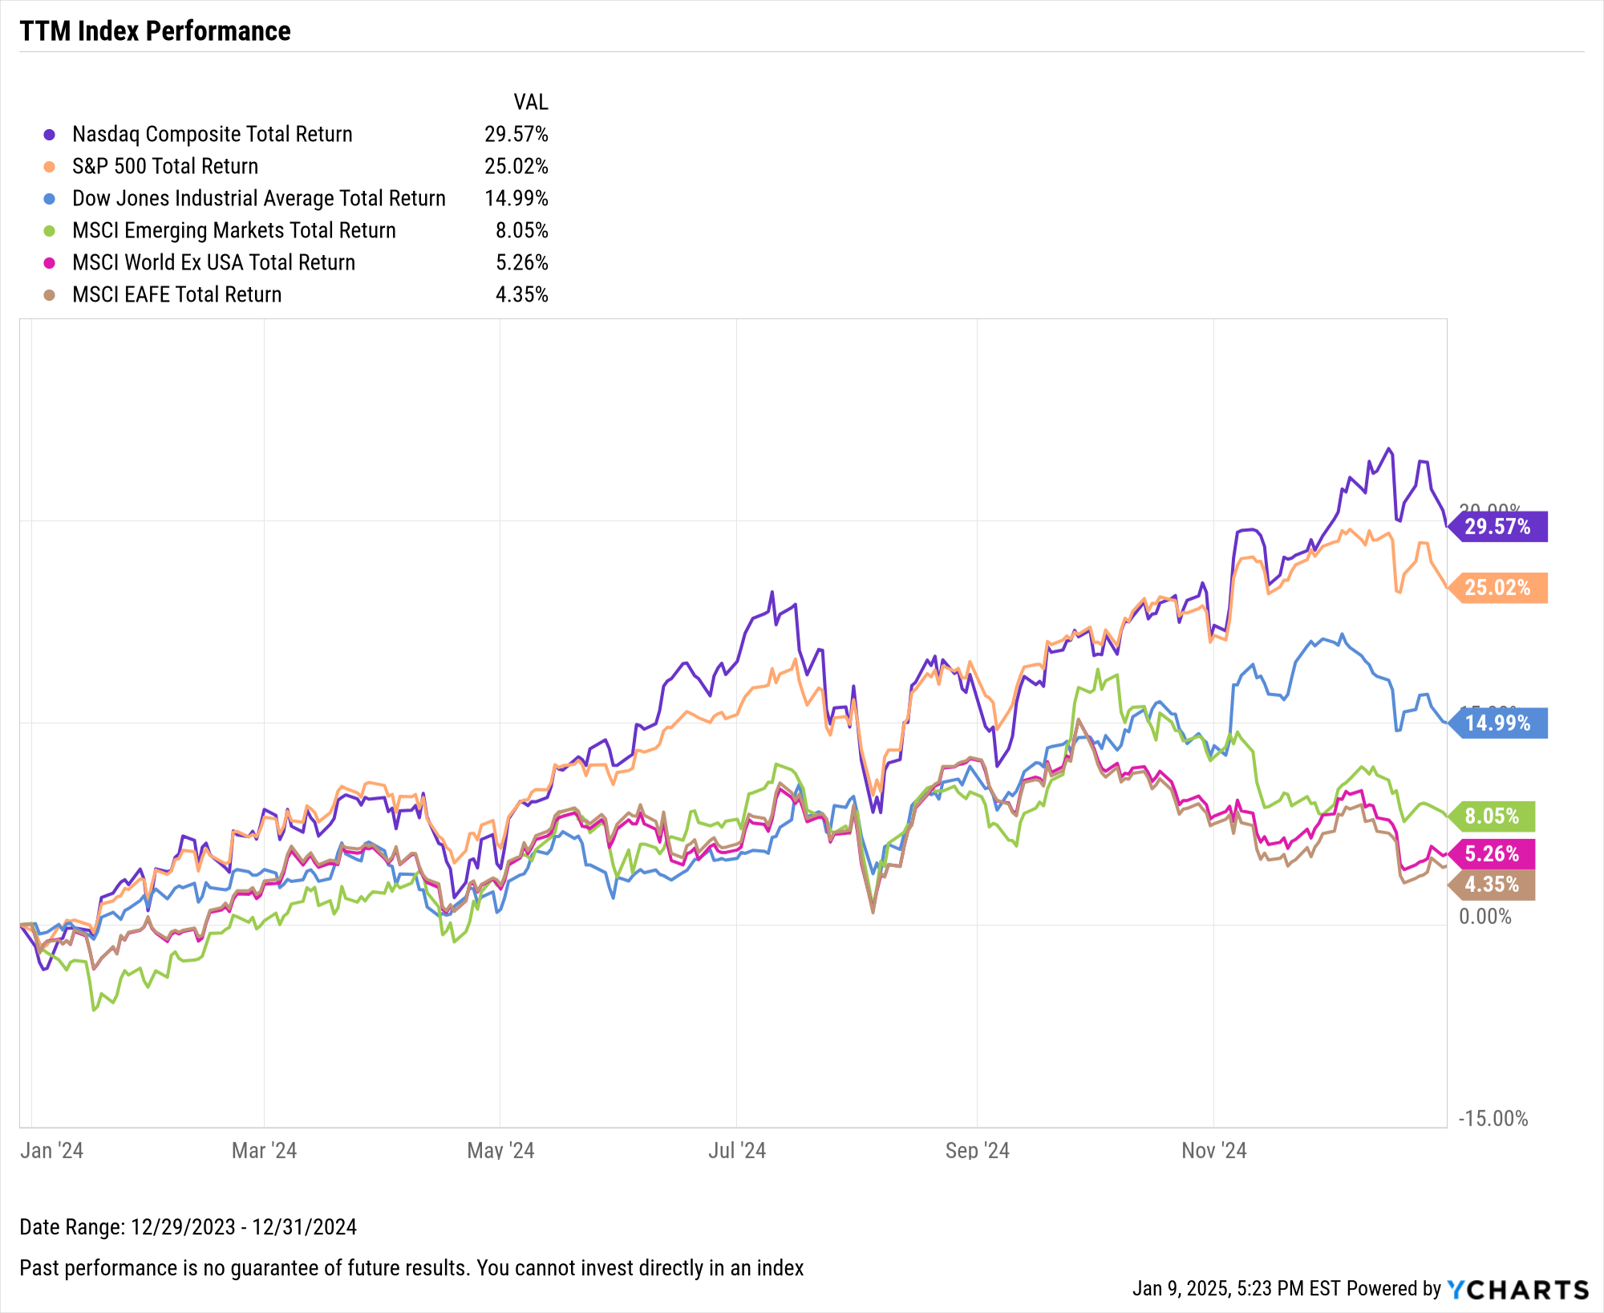
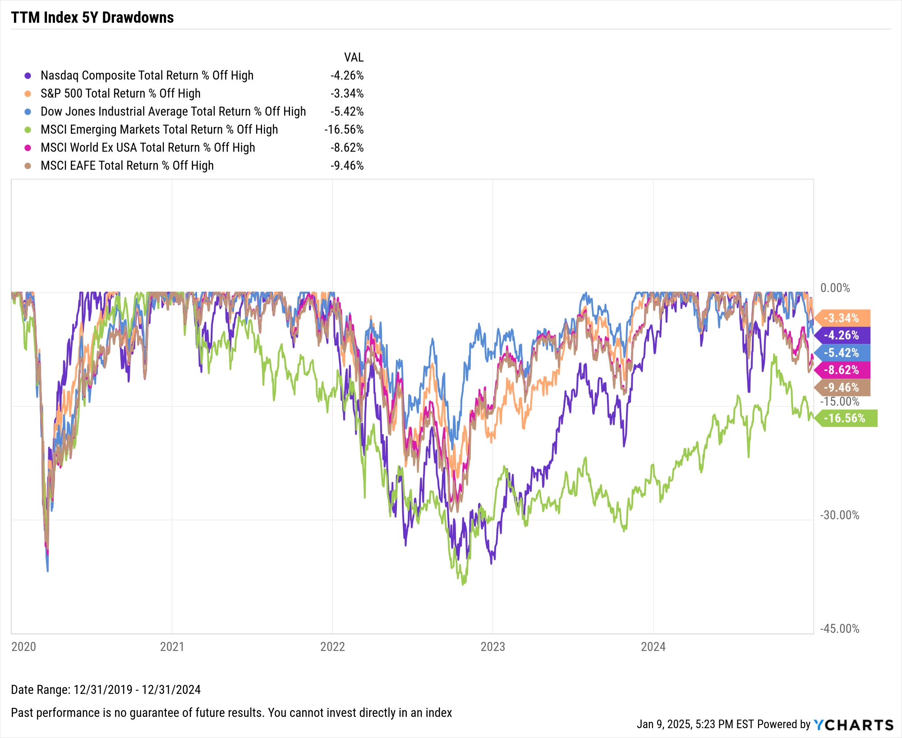
Key Stock Market Index Performance (cont.)
Notes:
L: TTM Index Returns, 12/31/2023 – 12/31/2024:
Nasdaq Composite Total Return: +29.57%
S&P 500 Total Return: +25.02%
Dow Jones Industrial Average Total Return: +14.99%
MSCI Emerging Markets Total Return: +8.05%
MSCI World Ex USA Total Return: +5.26%
MSCI EAFE Total Return: +4.35%
R: A market downturn in December pushed Developed Markets 9.5% off its five-year high, and Emerging Markets ended the year 16.6% below its high.

Slide 8
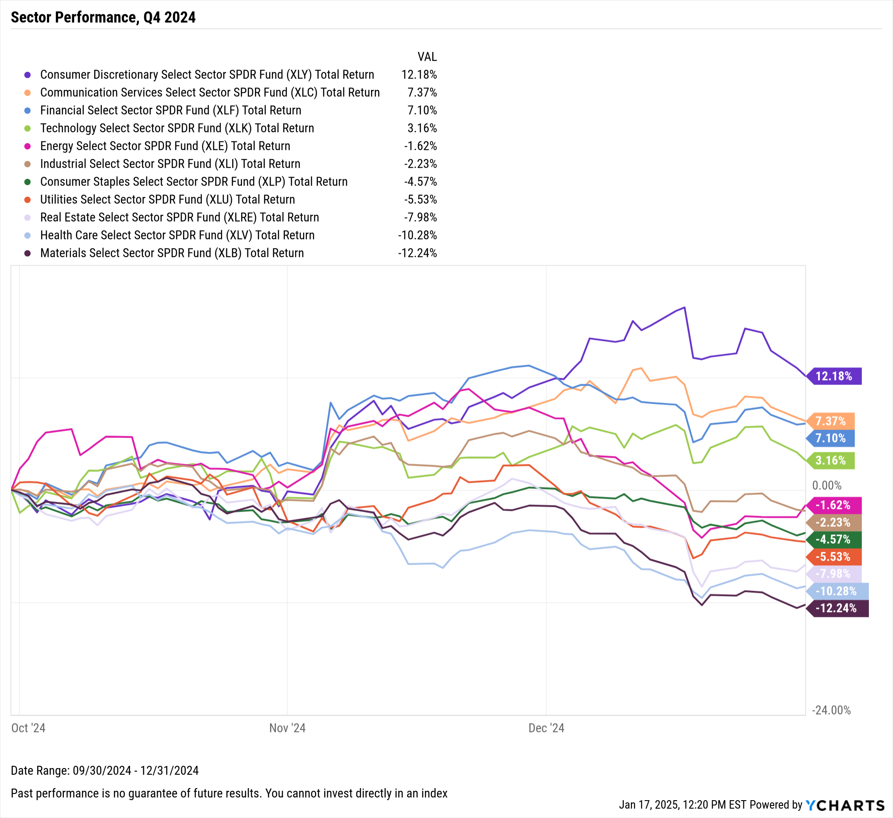
US Stock Sector Performance
Sensitive Sectors | Q4 2024 Return
Communication Services Select Sector SPDR® ETF | 7.37%
Energy Select Sector SPDR® ETF | -1.62%
Industrial Select Sector SPDR® ETF | -2.23%
Technology Select SPDR® ETF | 3.16%
Defensive Sectors | Q4 2024 Return
Consumer Staples Select Sector SPDR® ETF | -4.57%
Health Care Select Sector SPDR® ETF | -10.28%
Utilities Select Sector SPDR® ETF | -5.53%
Cyclical Sectors | Q4 2024 Return
Consumer Discretionary Select SPDR® ETF | 12.18%
Financial Select Sector SPDR® ETF | 7.10%
Materials Select Sector SPDR® ETF | -12.24%
Real Estate Select Sector SPDR® ETF | -7.98%
Notes:
Sector Total Returns for Q4 2024:
Consumer Discretionary: +12.18%
Communication Services: +7.37%
Financials: +7.10%
Technology: +3.16%
Energy: -1.62%
Industrials: -2.23%
Consumer Staples: -4.57%
Utilities: -5.53%
Real Estate: -7.98%
Health Care: -10.28%
Materials: -12.24%

Slide 9
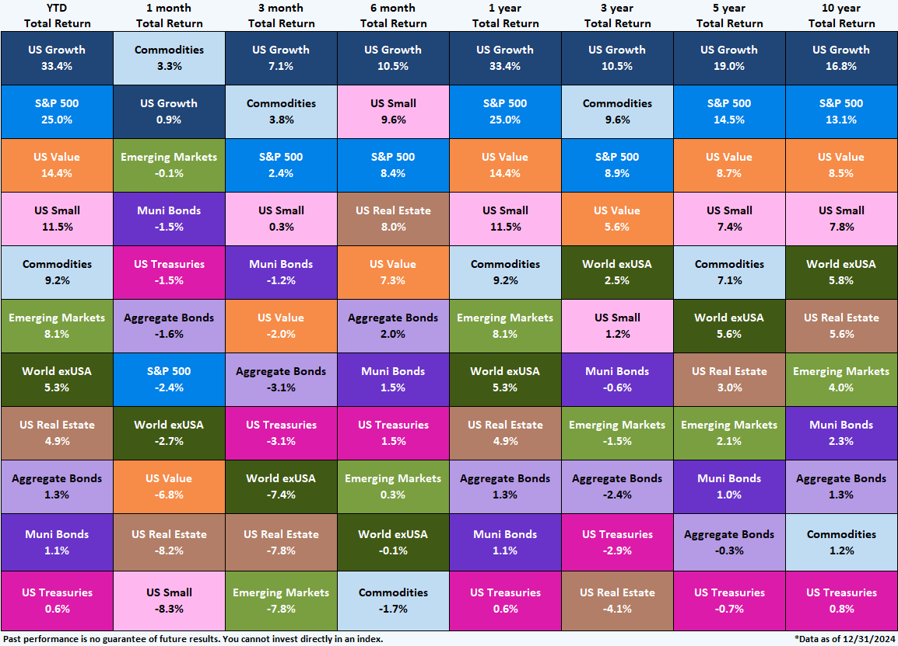
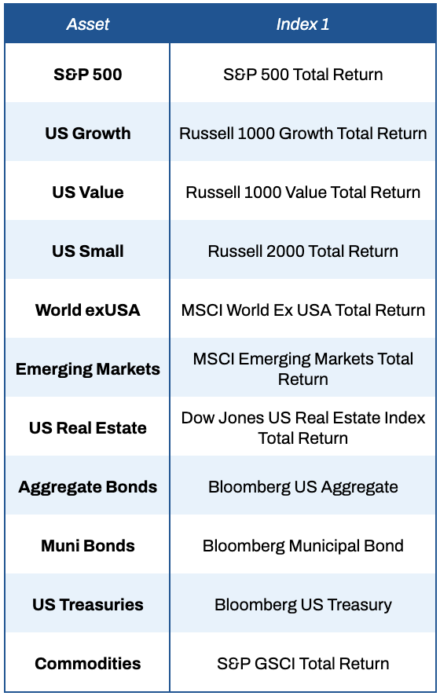
Asset Class Performance – Trailing Periods
3Y, 5Y, 10Y total returns annualized
Notes:
This table shows the performance of asset classes over different time frames.
US Growth was the best performing asset class on this heatmap with a 7.1% total return in Q4, placing it as the best performing asset class in the last 6M, 1Y, 3Y, 5Y, and 10Y. Commodities was the only negative asset class in Q3, but rebounded with a 3.8% total return in Q4 which puts it as the second-best performing asset class on this table.
Fixed income asset classes slipped due to spiking yields on the longer end of the curve. World exUSA, US Real Estate, and Emerging Markets took the biggest tumbles in Q4.

Slide 10
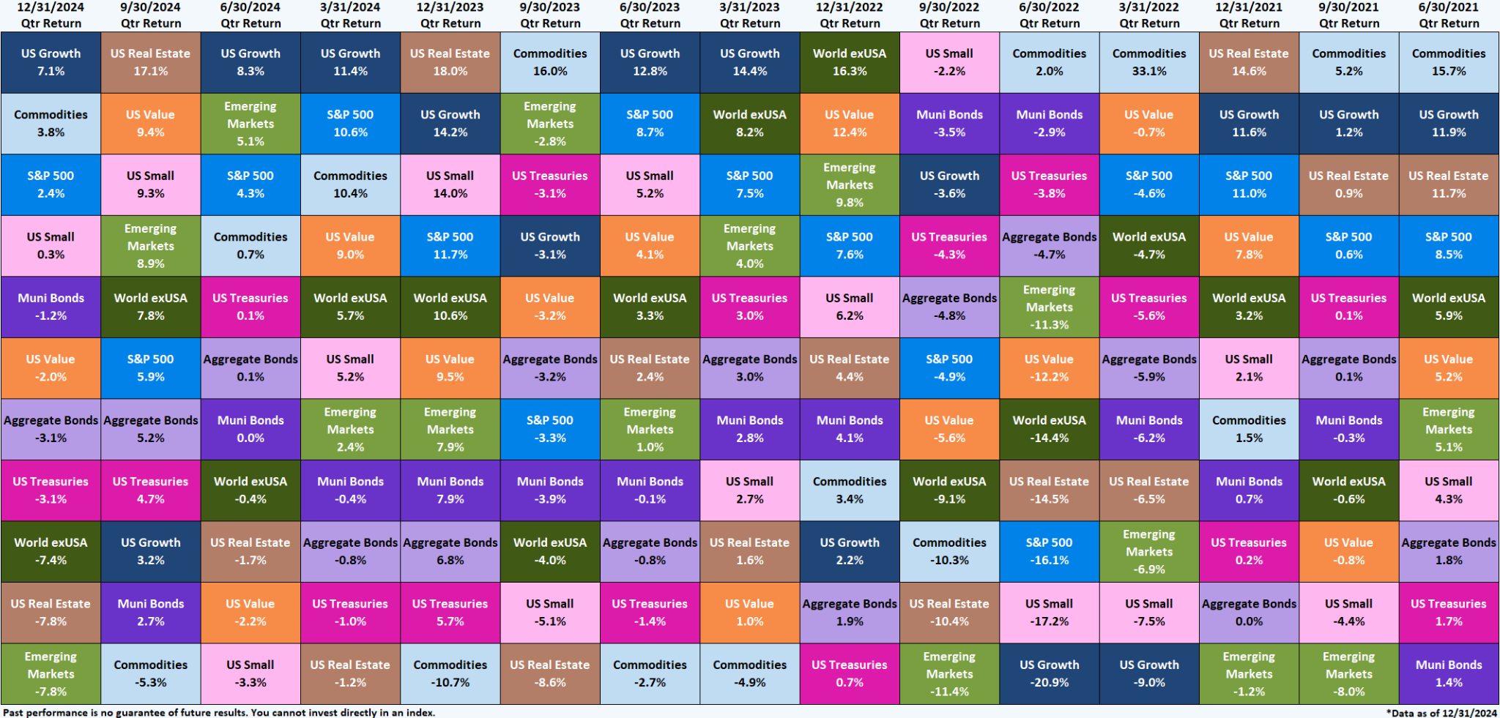
Asset Class Performance – Quarter by Quarter
Contact support@ycharts.com to access these asset class performance heatmaps
Notes:
This visual shows historical quarterly asset class performance for the last 15 quarters.
Q4 2024 Total Returns:
US Growth: +7.1%
Commodities: +3.8%
S&P 500: +2.4%
US Small Caps: +0.3%
Muni Bonds: -1.2%
US Value: -2.0%
Aggregate Bonds: -3.1%
US Treasuries: -3.1%
World exUSA: -7.4%
US Real Estate: -7.8%
Emerging Markets: -7.8%

Slide 11
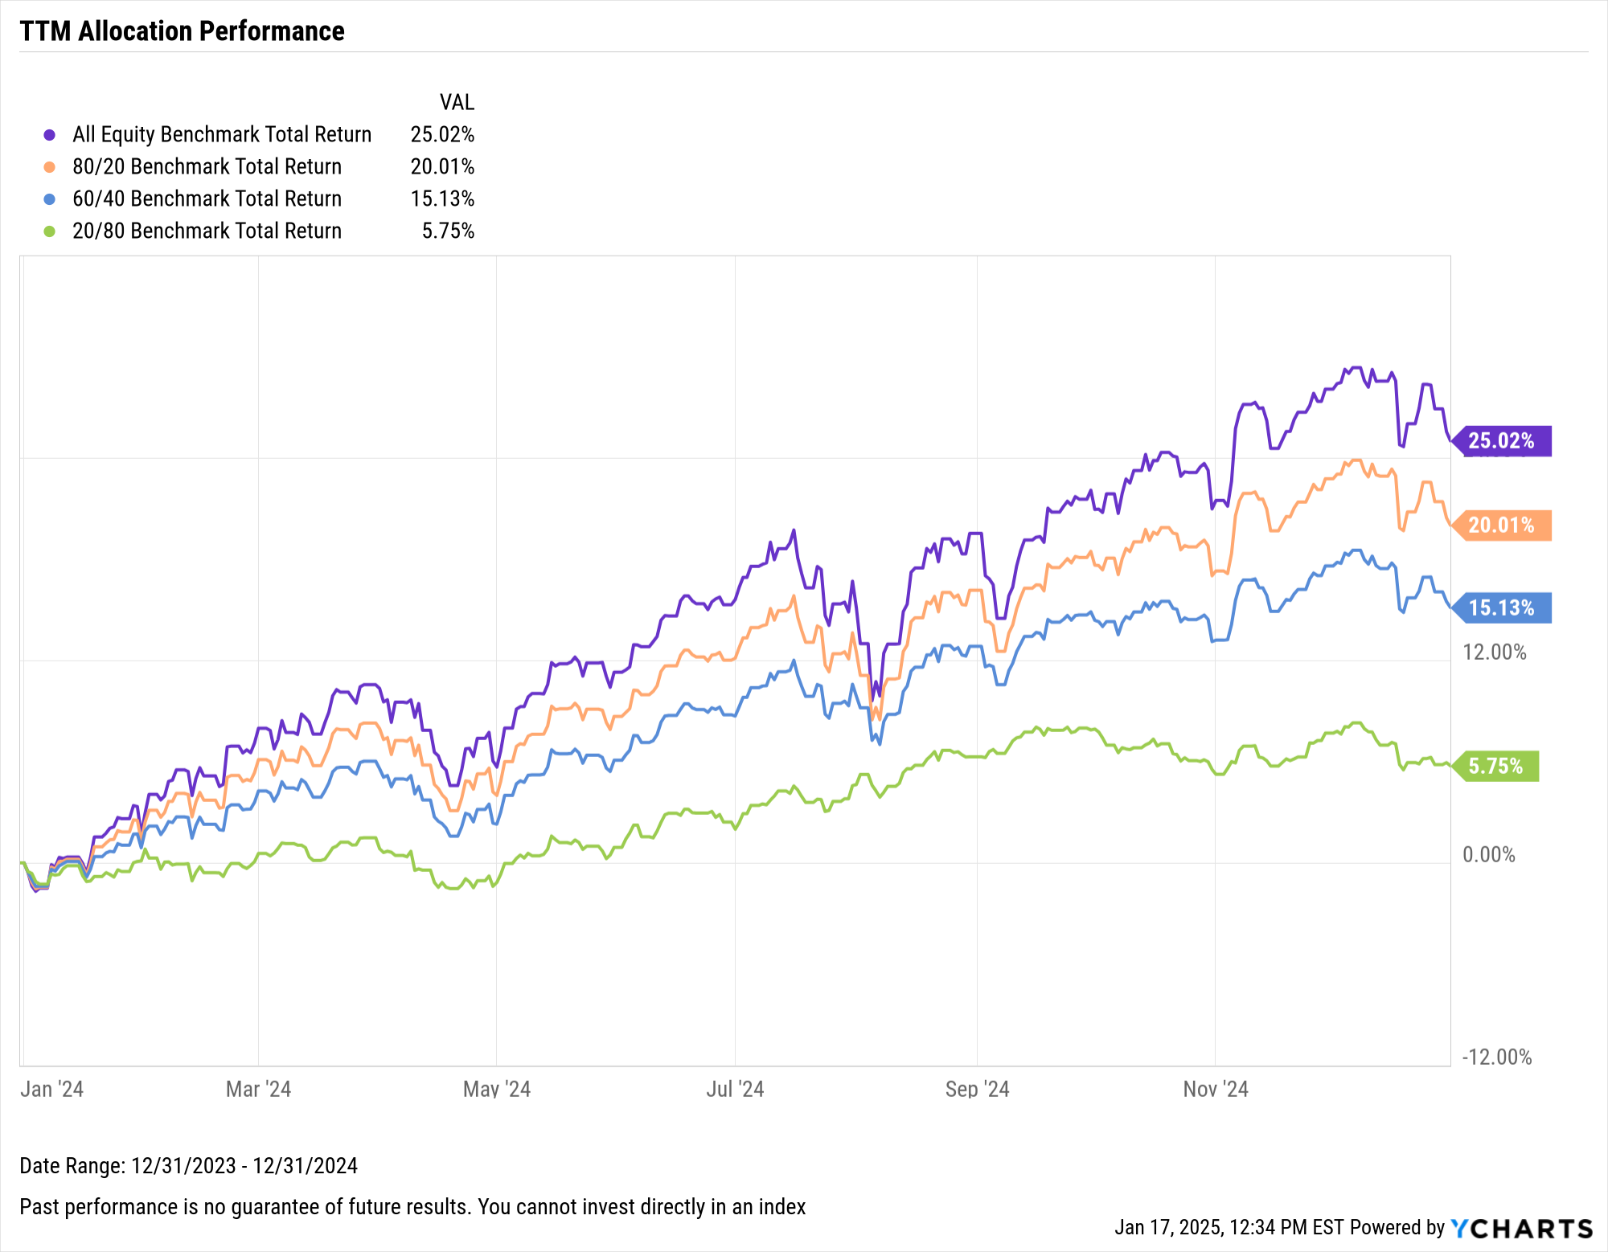
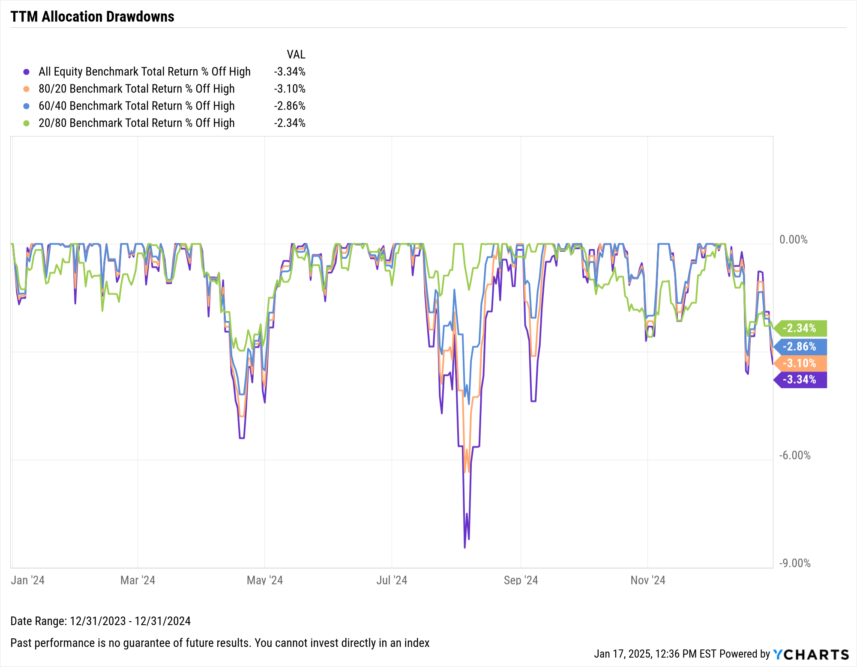
Performance of Diversified Portfolios
Notes:
This slide points out TTM total returns and max drawdowns of various risk vs. return strategies, including S&P 500/Bloomberg US Aggregate allocations of 100/0, 80/20, 50/50, and 20/80.
TTM Allocation Total Returns, 12/31/2023 – 12/31/2024:
All-S&P 500 Portfolio: +25.02%
Aggressive (80/20): +20.01%
Balanced (50/50): +15.13%
Conservative (20/80): +5.75%

Slide 12
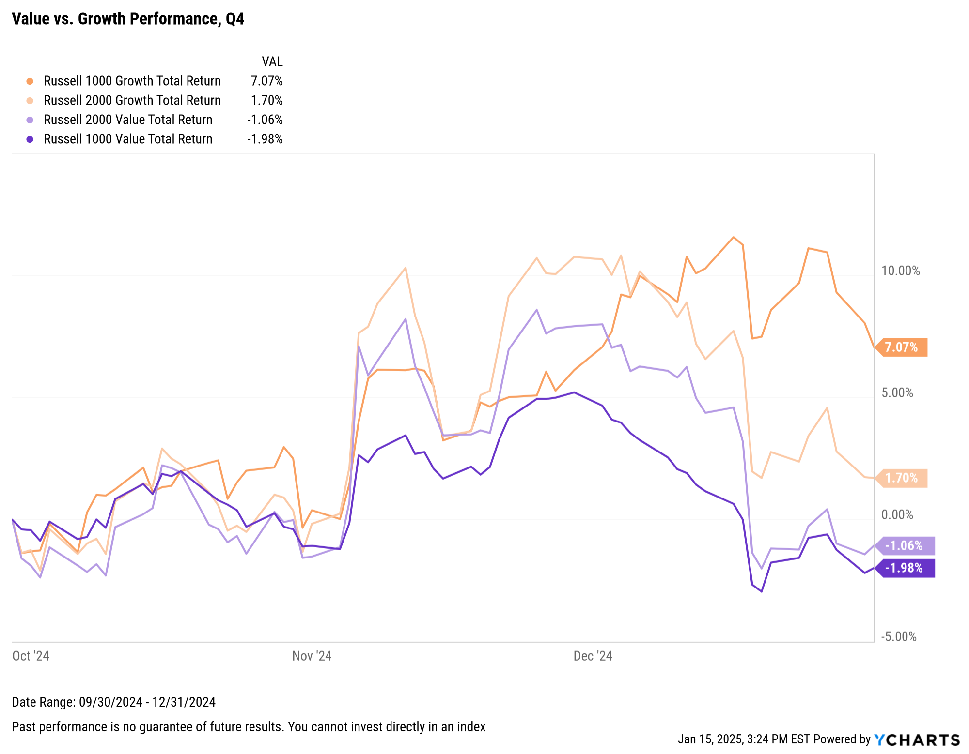
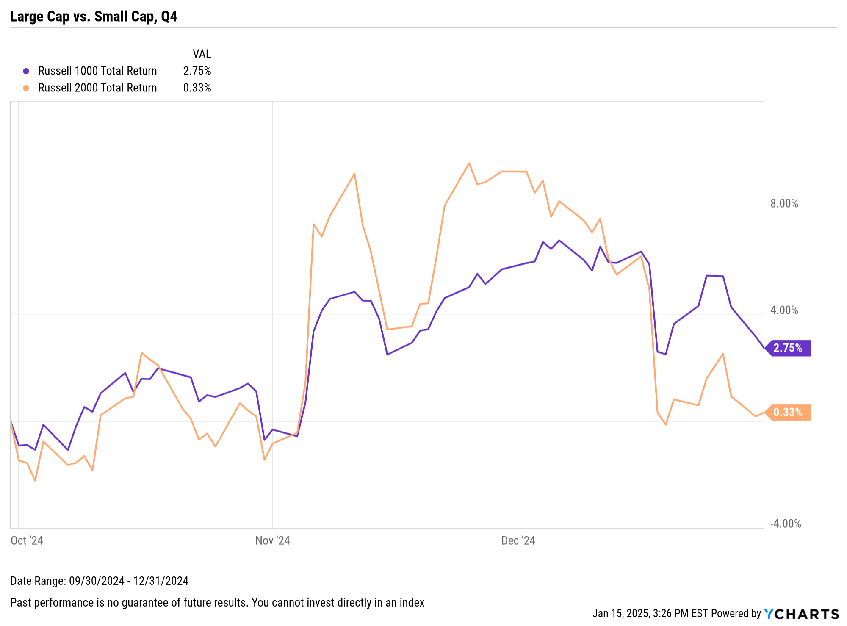
Equity Style Performance
Notes:
L: Style Box Total Returns for Q4 2024:
Large-Cap Growth: +7.07%
Small-Cap Growth: +1.70%
Small-Cap Value: -1.06%
Large-Cap Value: -1.98%
R: Index Total Returns for Q4 2024:
Russell 2000: +2.75%
Russell 1000: +0.33%

Slide 13
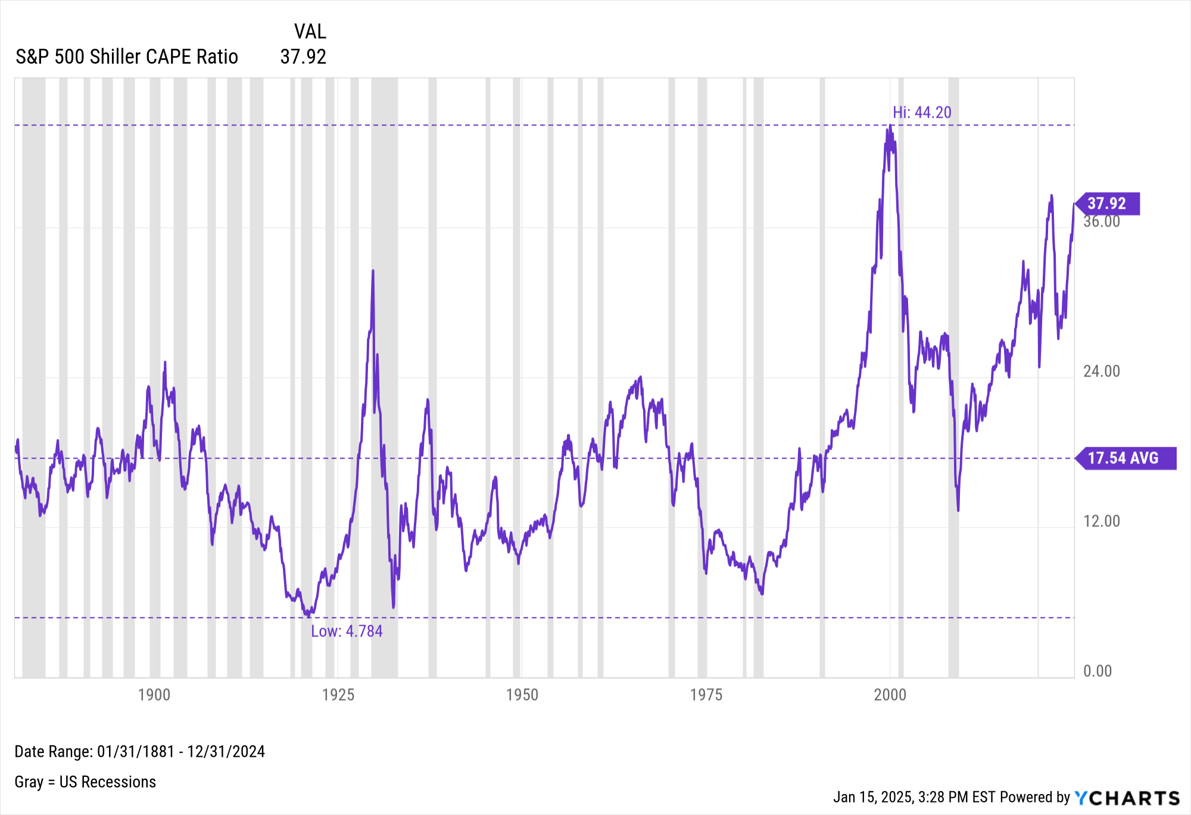
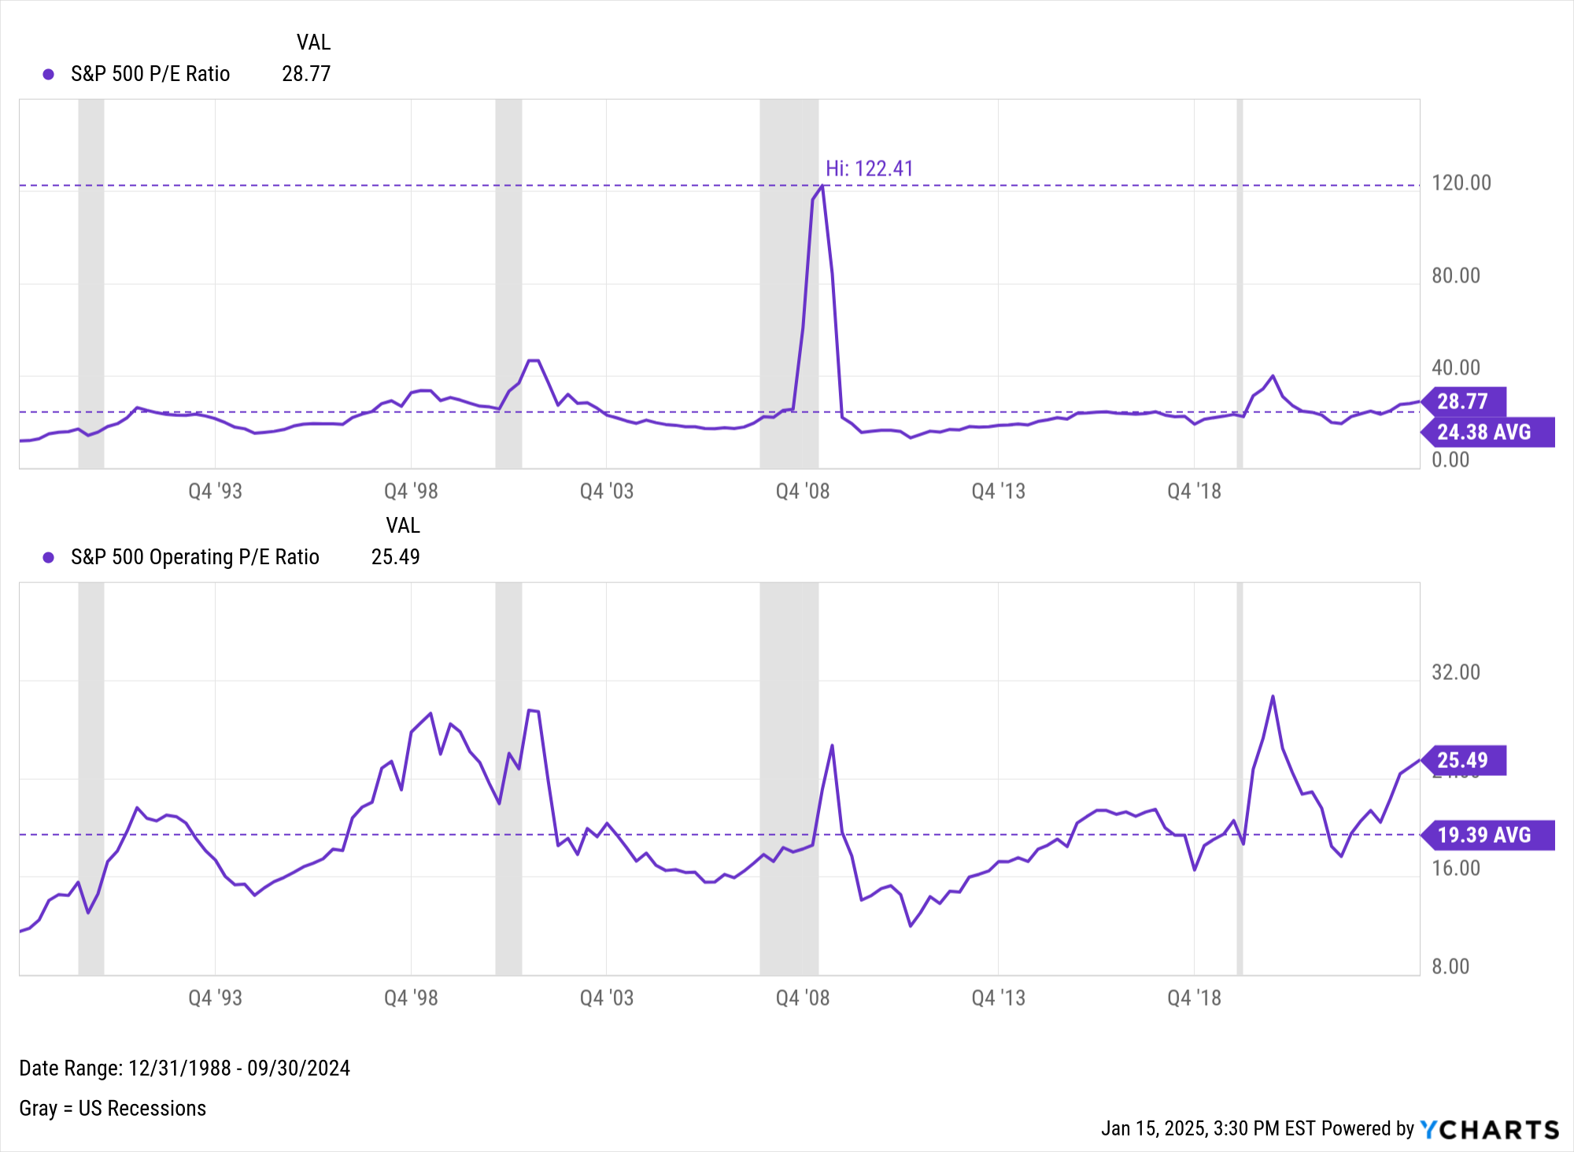
S&P 500 Valuation Measures
Notes:
S&P 500 Valuations:
S&P 500 CAPE Ratio: 37.92 as of December 31st, 2024 (Above historical average of 17.54)
S&P 500 P/E Ratio: 28.77 as of September 30th, 2024 (Above historical average of 24.38)
S&P 500 Operating P/E Ratio: 25.49 as of September 30th, 2024 (Above historical average of 19.39)

Slide 14
Macroeconomic Data
Leading and Lagging Economic Data and Trends from Key Economic Reports Published Recently

Slide 15
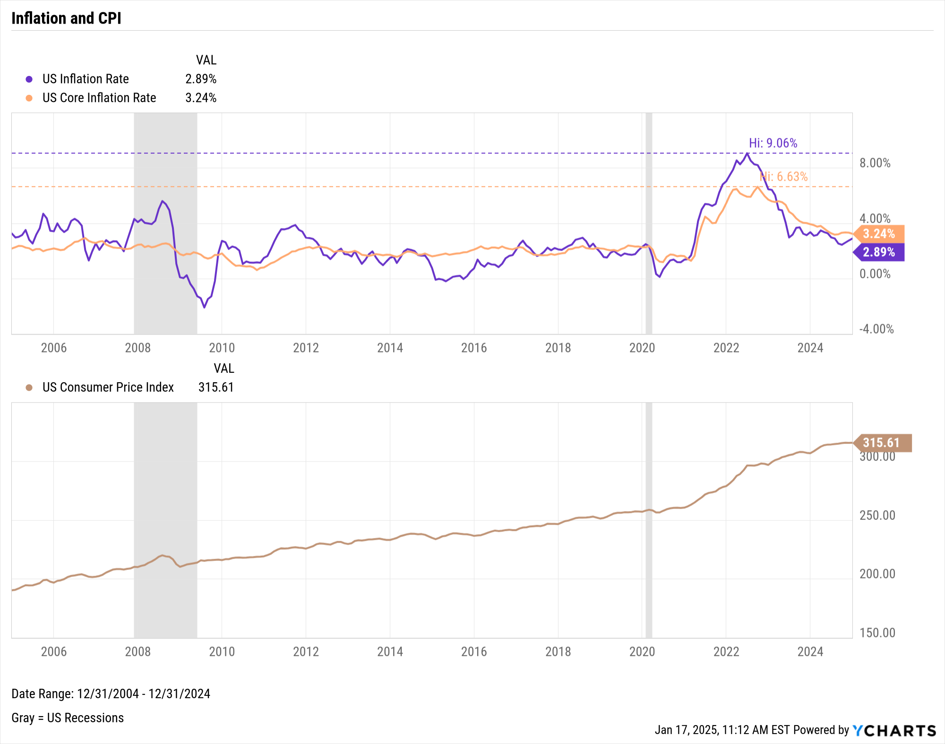
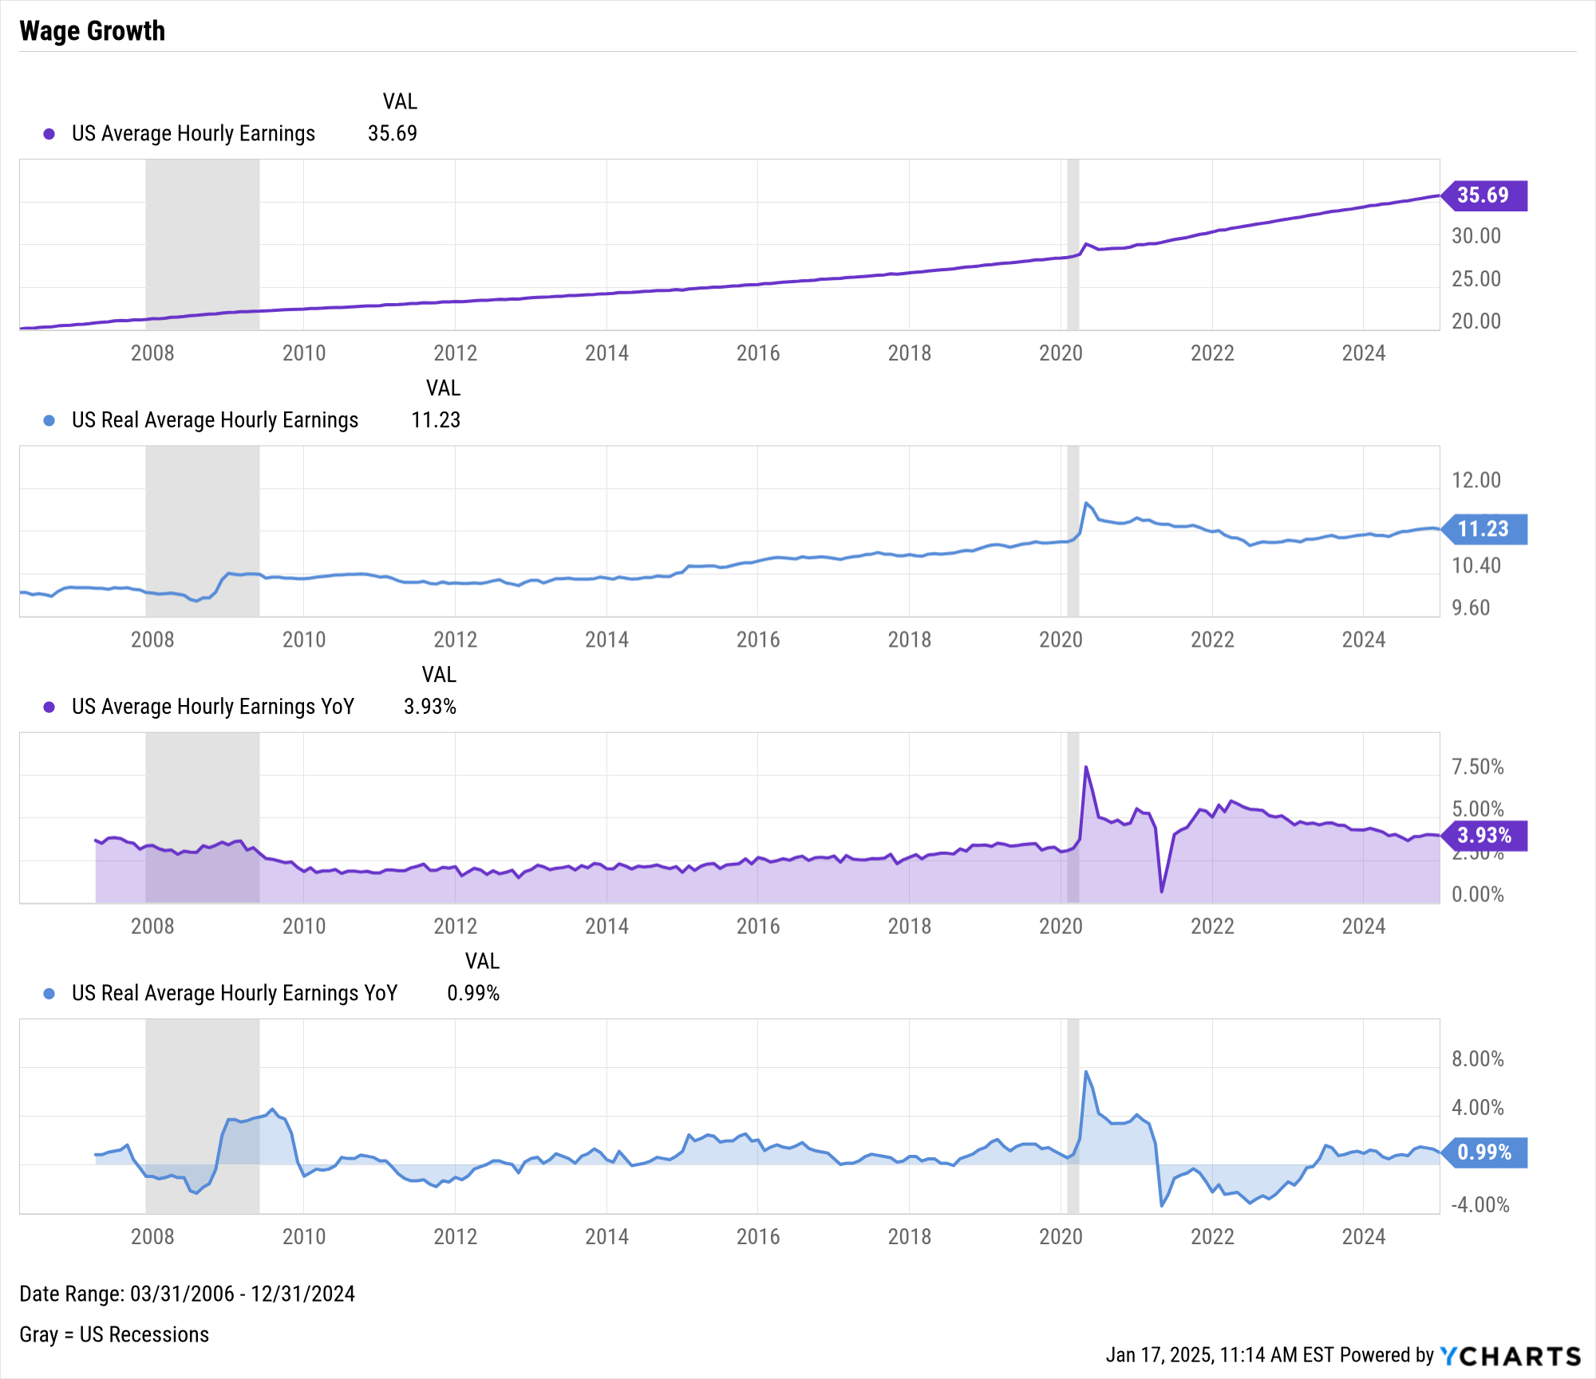
Inflation & Wage Growth
Notes:
L: As of December 2024:
US Inflation Rate: 2.89%
US Core Inflation Rate: 3.24%
US Consumer Price Index: 315.61
R: As of September 2024:
US Average Hourly Earnings: 35.69 (all-time high)
US Real Average Hourly Earnings: 11.23 (-4.1% below its high set in April 2020)
US Average Hourly Earnings YoY: +3.93%
US Real Average Hourly Earnings YoY: +0.99%

Slide 16
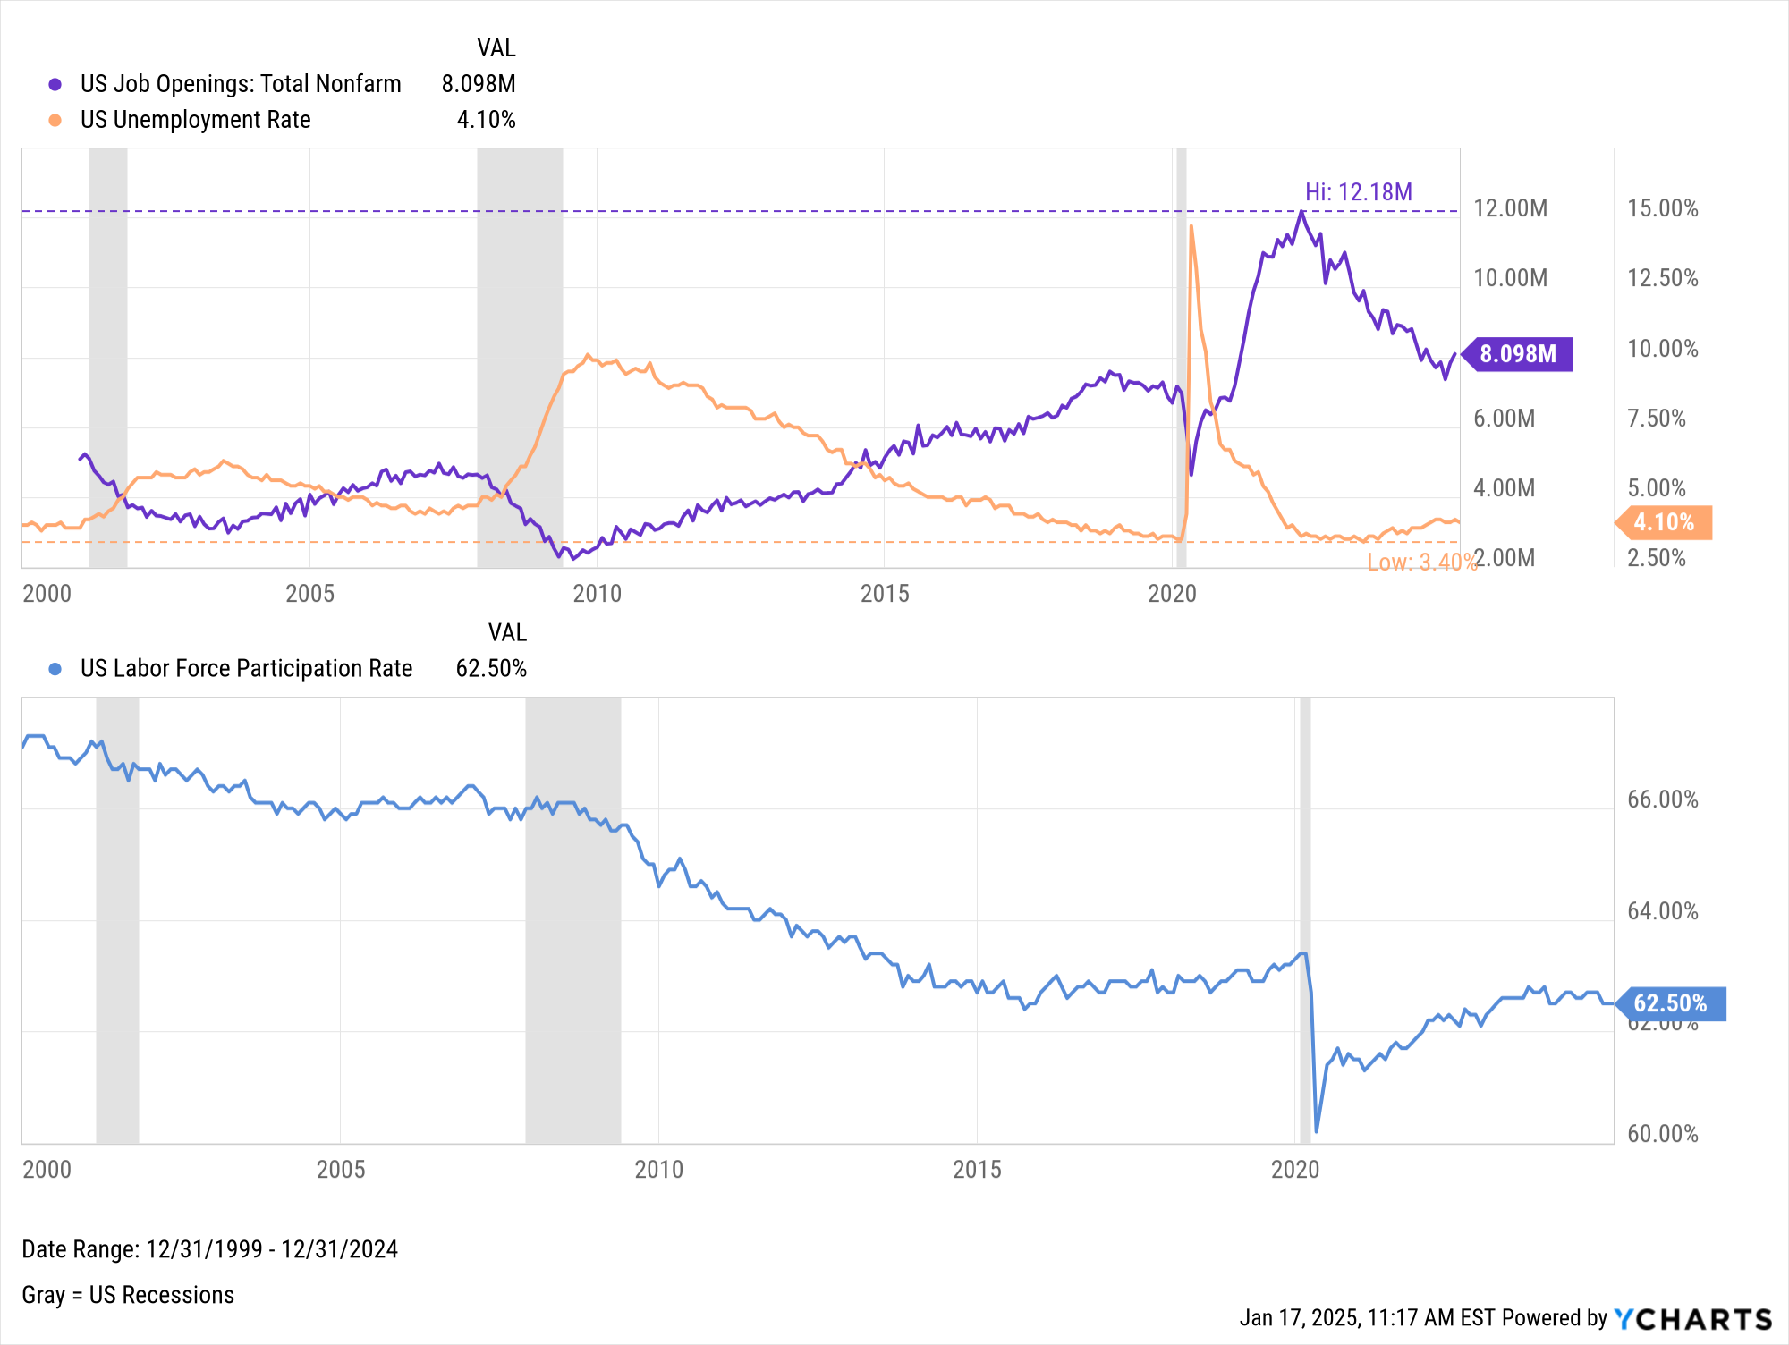
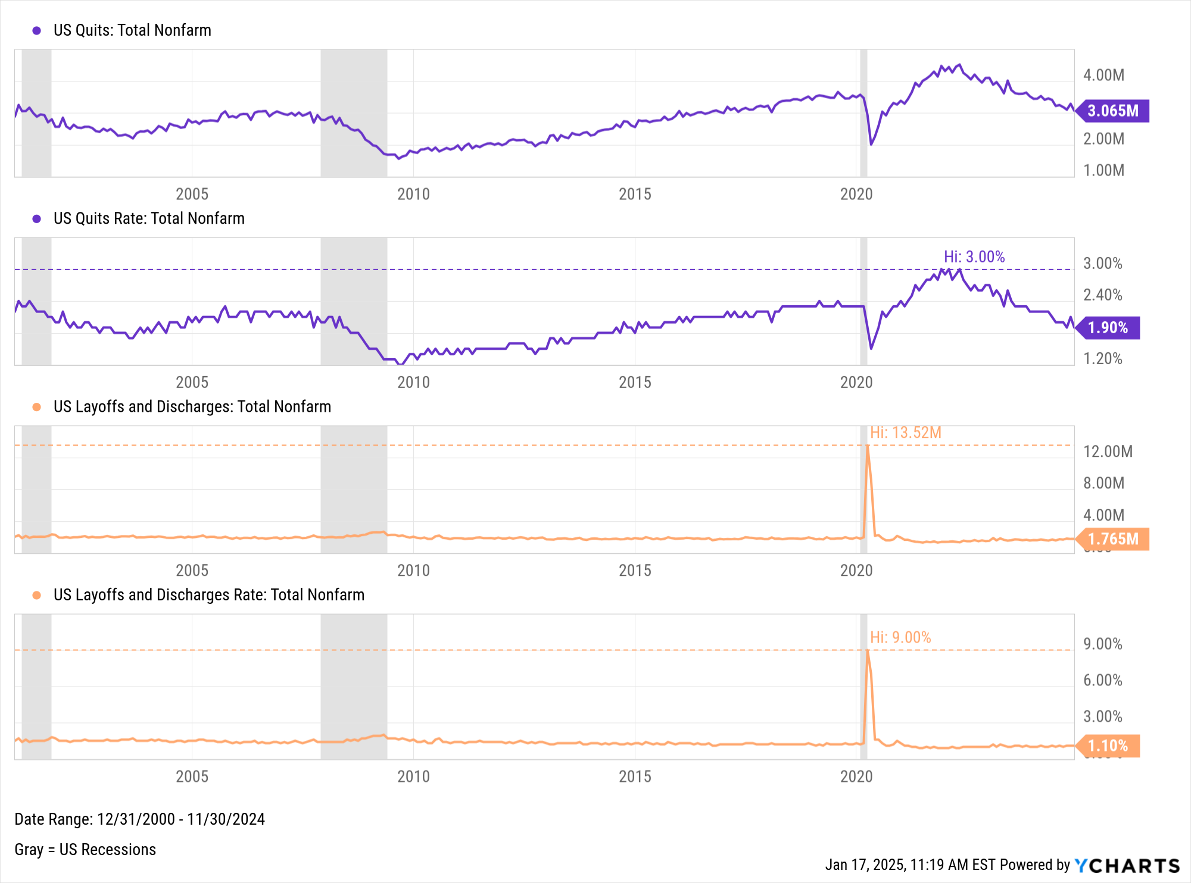
Employment
Notes:
L: As of December 2024:
Total US Job Nonfarm Openings: 8.098M (as of November 2024)
US Unemployment Rate: 4.10%
US Labor Force Participation Rate: 62.50%
R: As of November 2024:
US Quits: 3.065M
US Quits Rate: 1.90%
US Layoffs and Discharges: 1.765M
US Layoffs and Discharges Rate: 1.10%

Slide 17
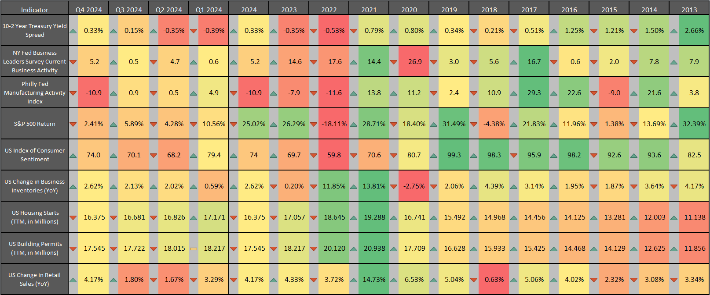
Leading Indicator Data and Trends
Contact support@ycharts.com to access this heatmap
Notes:
Latest values as of December 2024/Q4 2024:
10-2 Year Treasury Yield Spread: 0.33%
NY Fed Business Leaders Survey Current Business Activity: -5.2
Philly Fed Manufacturing Activity Index: -10.9
S&P 500 Total Return: -2.41% for Q4 2024
US Index of Consumer Sentiment: 74.0
US Change in Business Inventories YoY: +2.62%
US Housing Starts (TTM total): 16.375M
US Building Permits (TTM total): 17.545M
US Change in Retail Sales YoY: +4.17%
Last four quarters: The green/red arrows to the left of each cell indicate a higher/lower change in that indicator’s value from the previous quarter
2013-2024: The green/red arrows to the left of each cell indicate a higher/lower change in that indicator’s value from the previous year

Slide 18
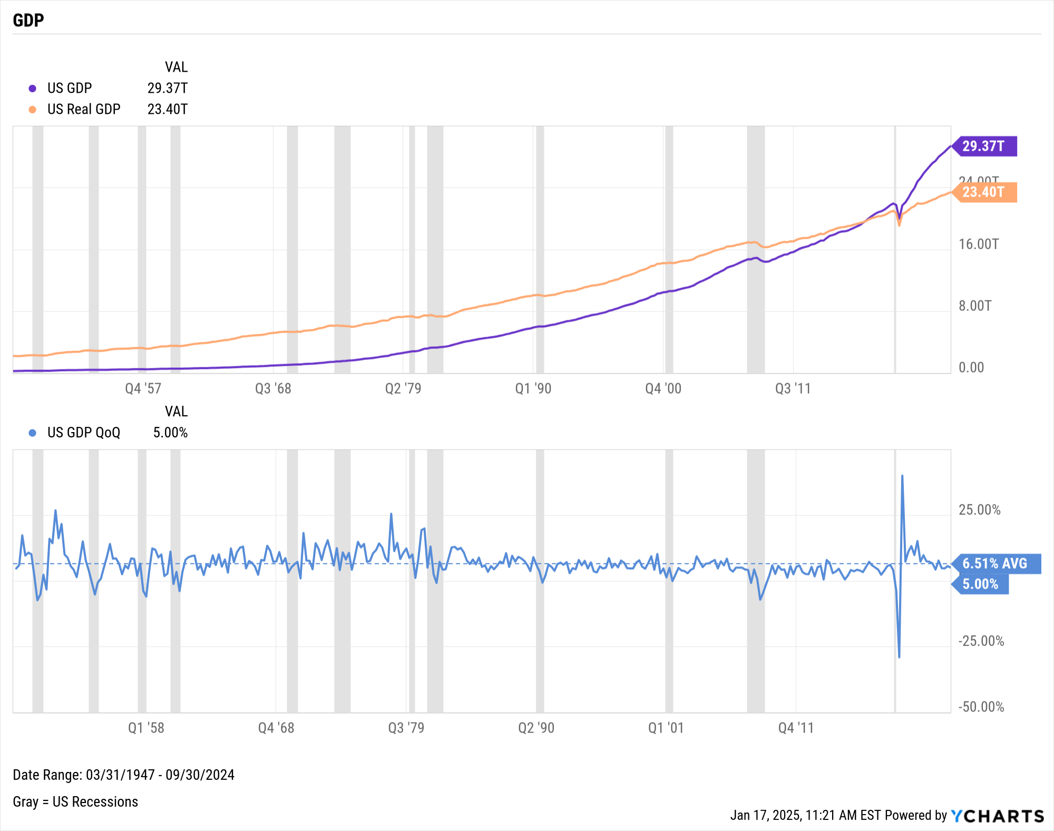
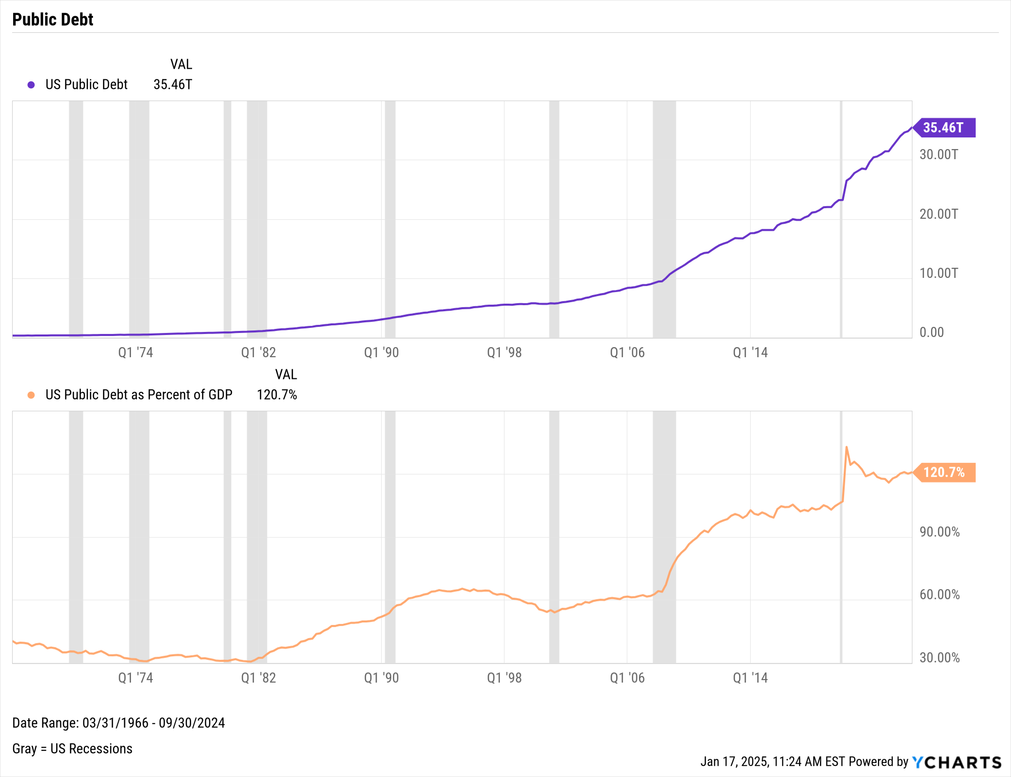
GDP & Public Debt
Notes:
L: As of Q3 2024:
US GDP: $29.37T
US Real GDP: $23.40T
US GDP % change, Q2 to Q3: 5.00%
R: As of Q3 2024:
US Public Debt: $35.46T
US Public Debt as a Percent of GDP: 120.7%

Slide 19
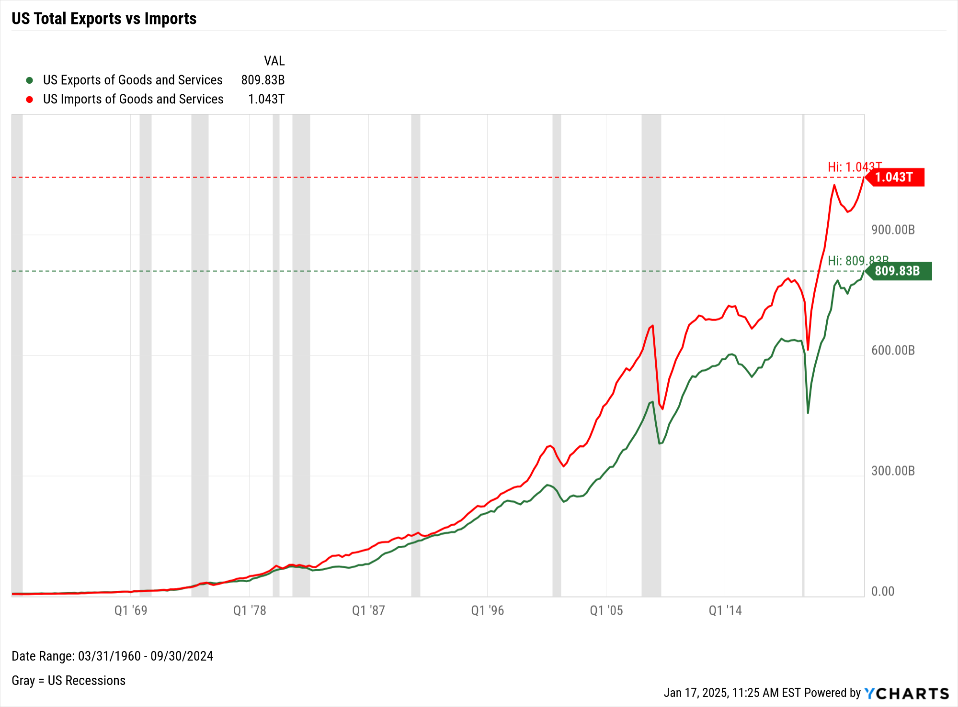
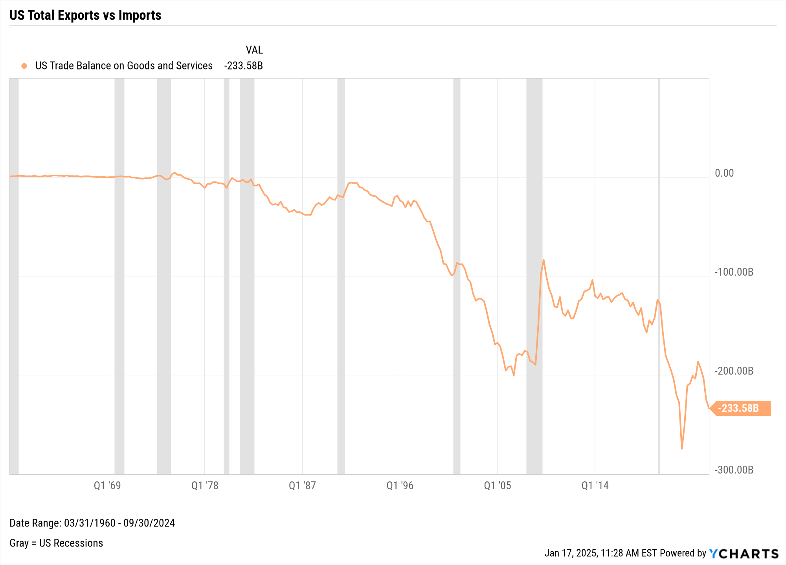
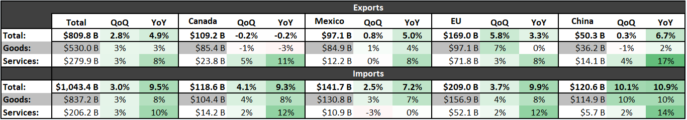
US Trade Balance
Notes:
This slide shows the US trade activity through Q3 2024 (the latest data available).
L:
US Exports of Goods and Services: $809.83B
US Imports of Goods and Services: $1.043T
R:
US Trade Balance between Goods and Services: -$233.58B
The table at the bottom shows trade activity between the USA and other key partners for Q3 2024. For example, the US saw $141.7B worth of combined goods and services imports from Mexico in Q3 2024, which is 7.2% more than that same figure a year ago from Q3 2023.

Slide 20
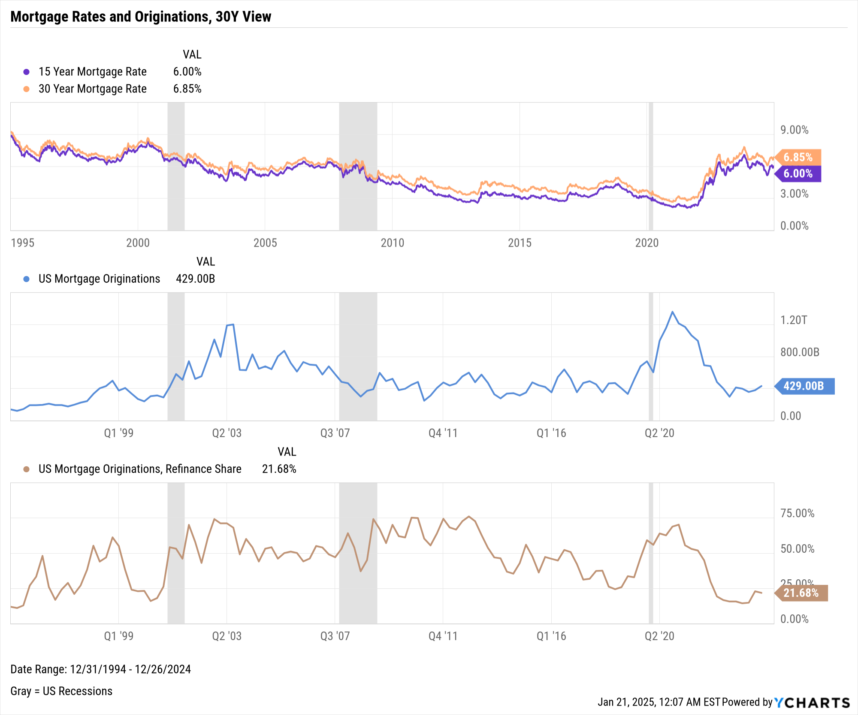
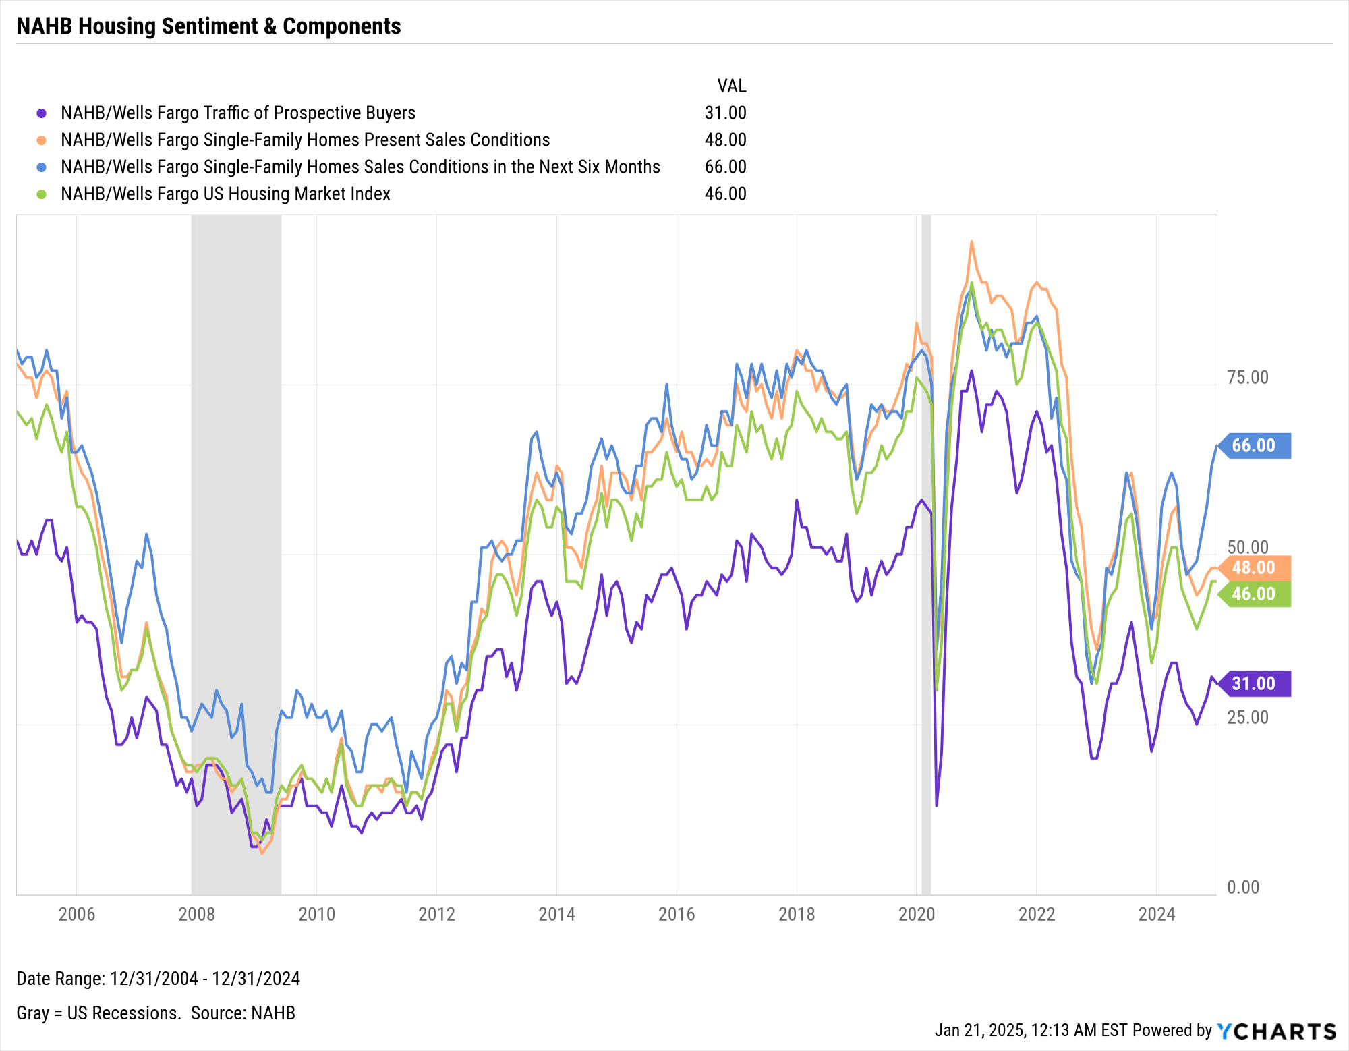
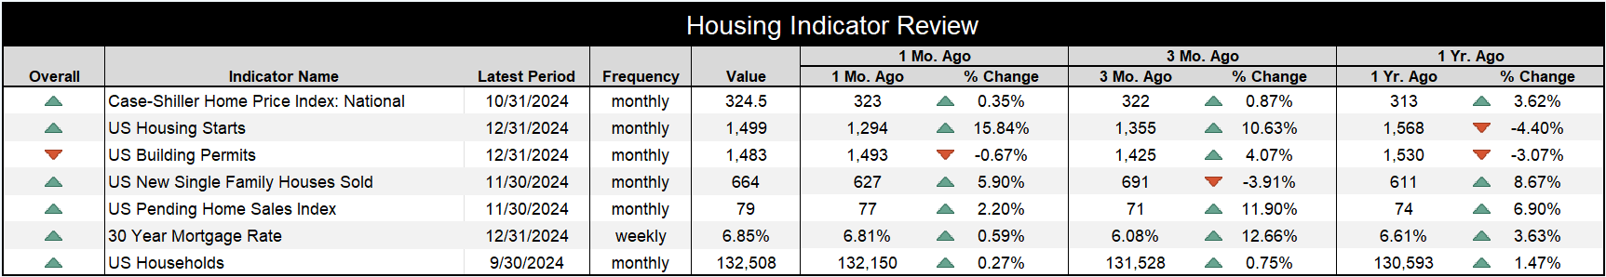
US Housing Market Data
Notes:
L: As of December 31st, 2024:
15-Year Mortgage Rate: 6.00%
30-Year Mortgage Rate: 6.85%
US Mortgage Originations: $429.00B (as of Q2 2024)
US Mortgage Originations, Refinance Share: 21.68% (as of Q2 2024)
R: NAHB/Wells Fargo data as of December 31st, 2024:
Traffic of Prospective Buyers: 31.00
Single-Family Homes Present Sales Conditions: 48.00
Single-Family Homes Sales Conditions in the Next Six Months: 66.00
US Housing Market Index: 46.00
Table:
National Case-Shiller Home Price Index: 324.5 (10/31/2024)
US Housing Starts: 1,499 (12/31/2024)
US Building Permits: 1,483 (12/31/2024)
US New Single Family Houses Sold: 664 (11/30/2024)
US Pending Home Sales Index: 79 (11/30/2024)
30-Year Mortgage Rate: 6.85% (12/31/2024)
US New Households: 132,508 (9/30/2024)

Slide 21
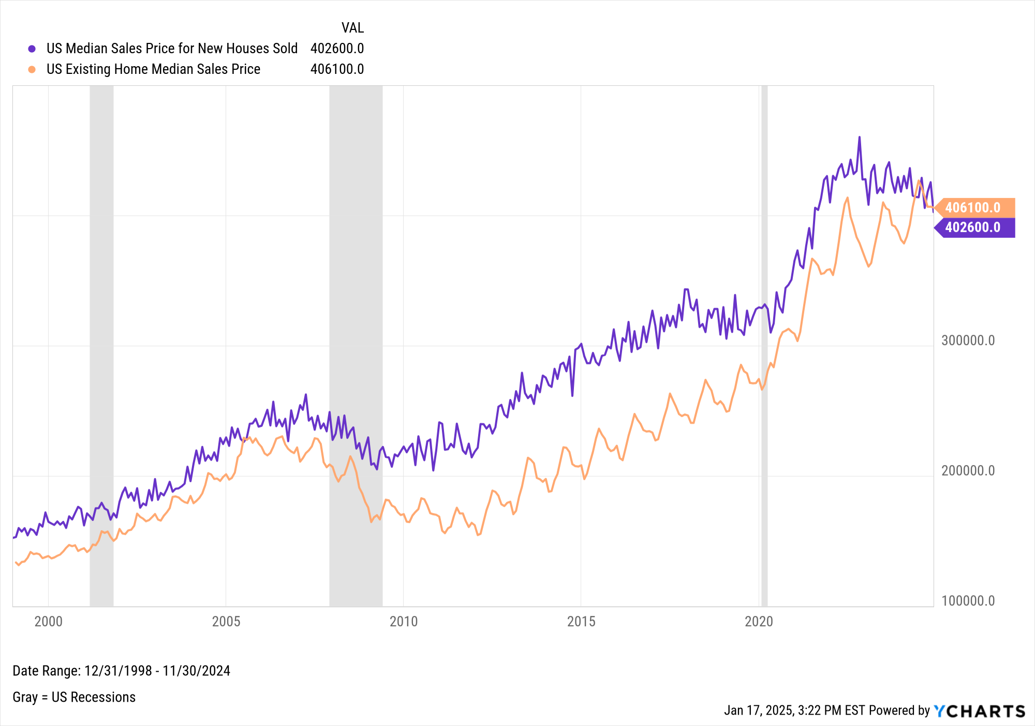
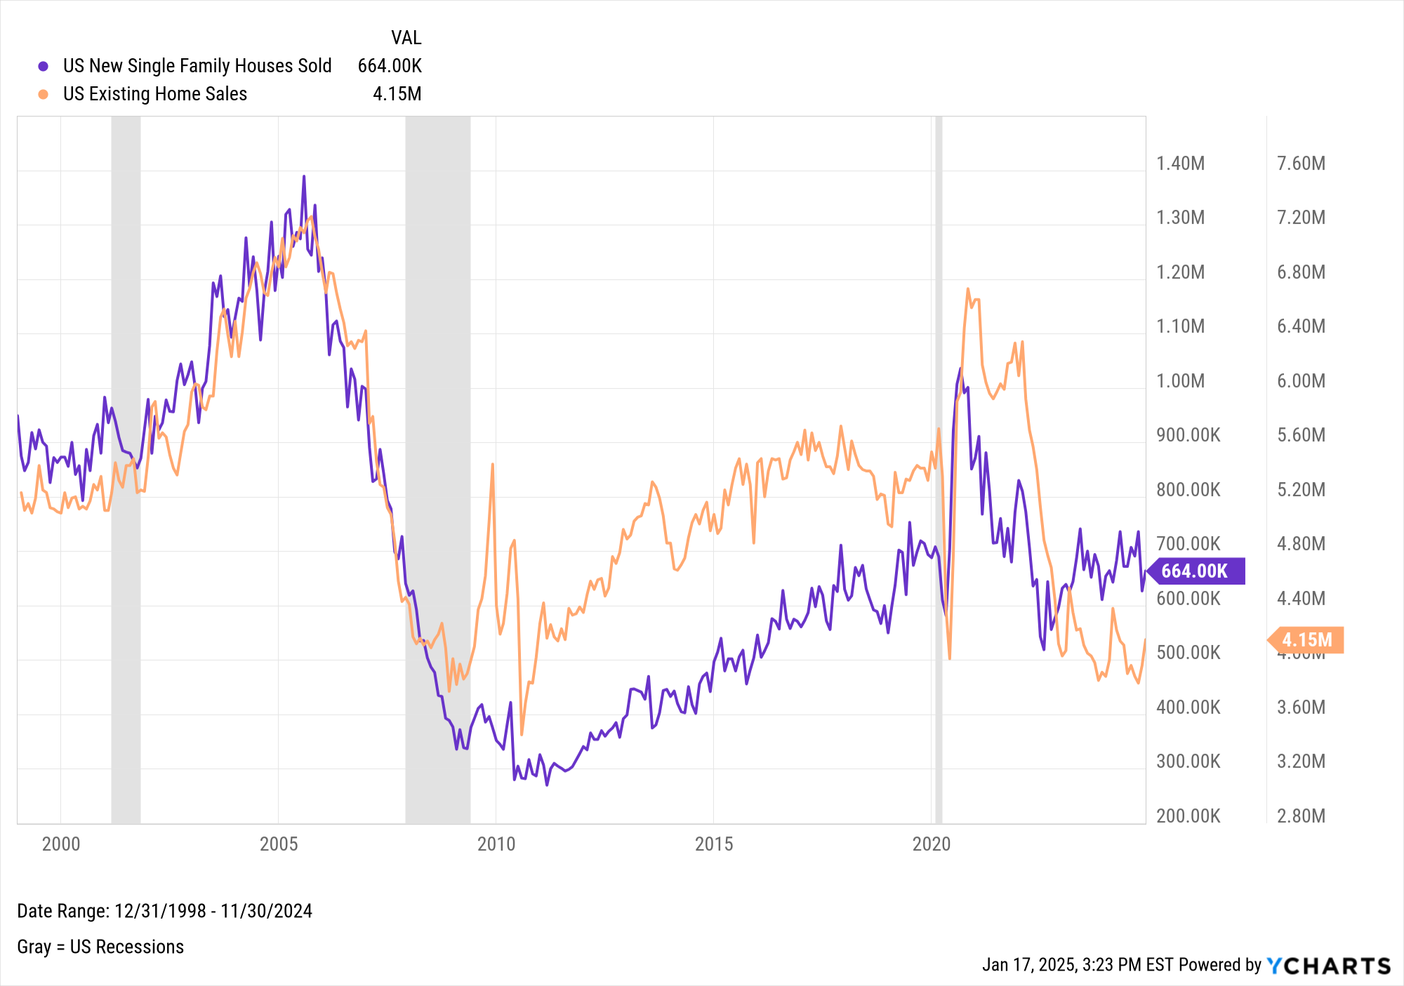
US Housing Market Data (cont.)
Notes:
L: As of November 30th, 2024:
US Median Sales Price for New Houses Sold: $402,600
US Existing Home Median Sales Price: $406,100
R: As of November 30th, 2024:
US New Single Family Houses Sold: 664K
US Existing Home Sales: 4.15M

Slide 22

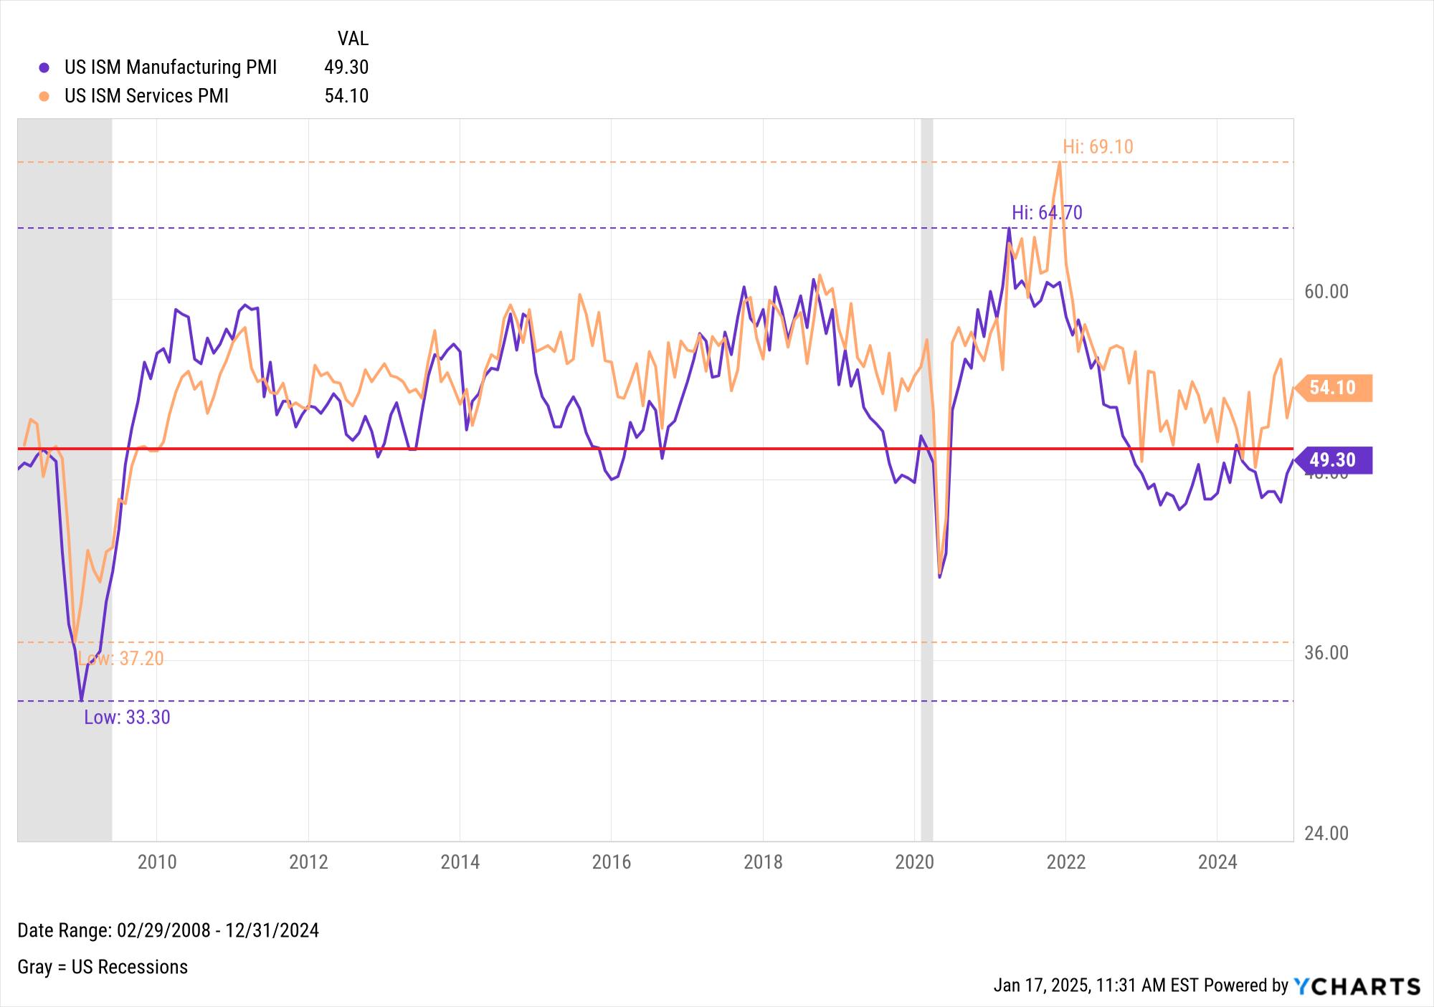
Manufacturing & Services
Notes:
As of December 31st, 2024:
US ISM Manufacturing PMI: 49.30
US ISM Services PMI: 54.10
According to Institute of Supply Management Purchasing Manager Indexes, the Manufacturing sector has only produced one reading above 50 since October 2022 (March 2024), while the Services sector has been advancing higher into expansion territory since July 2024.

Slide 23
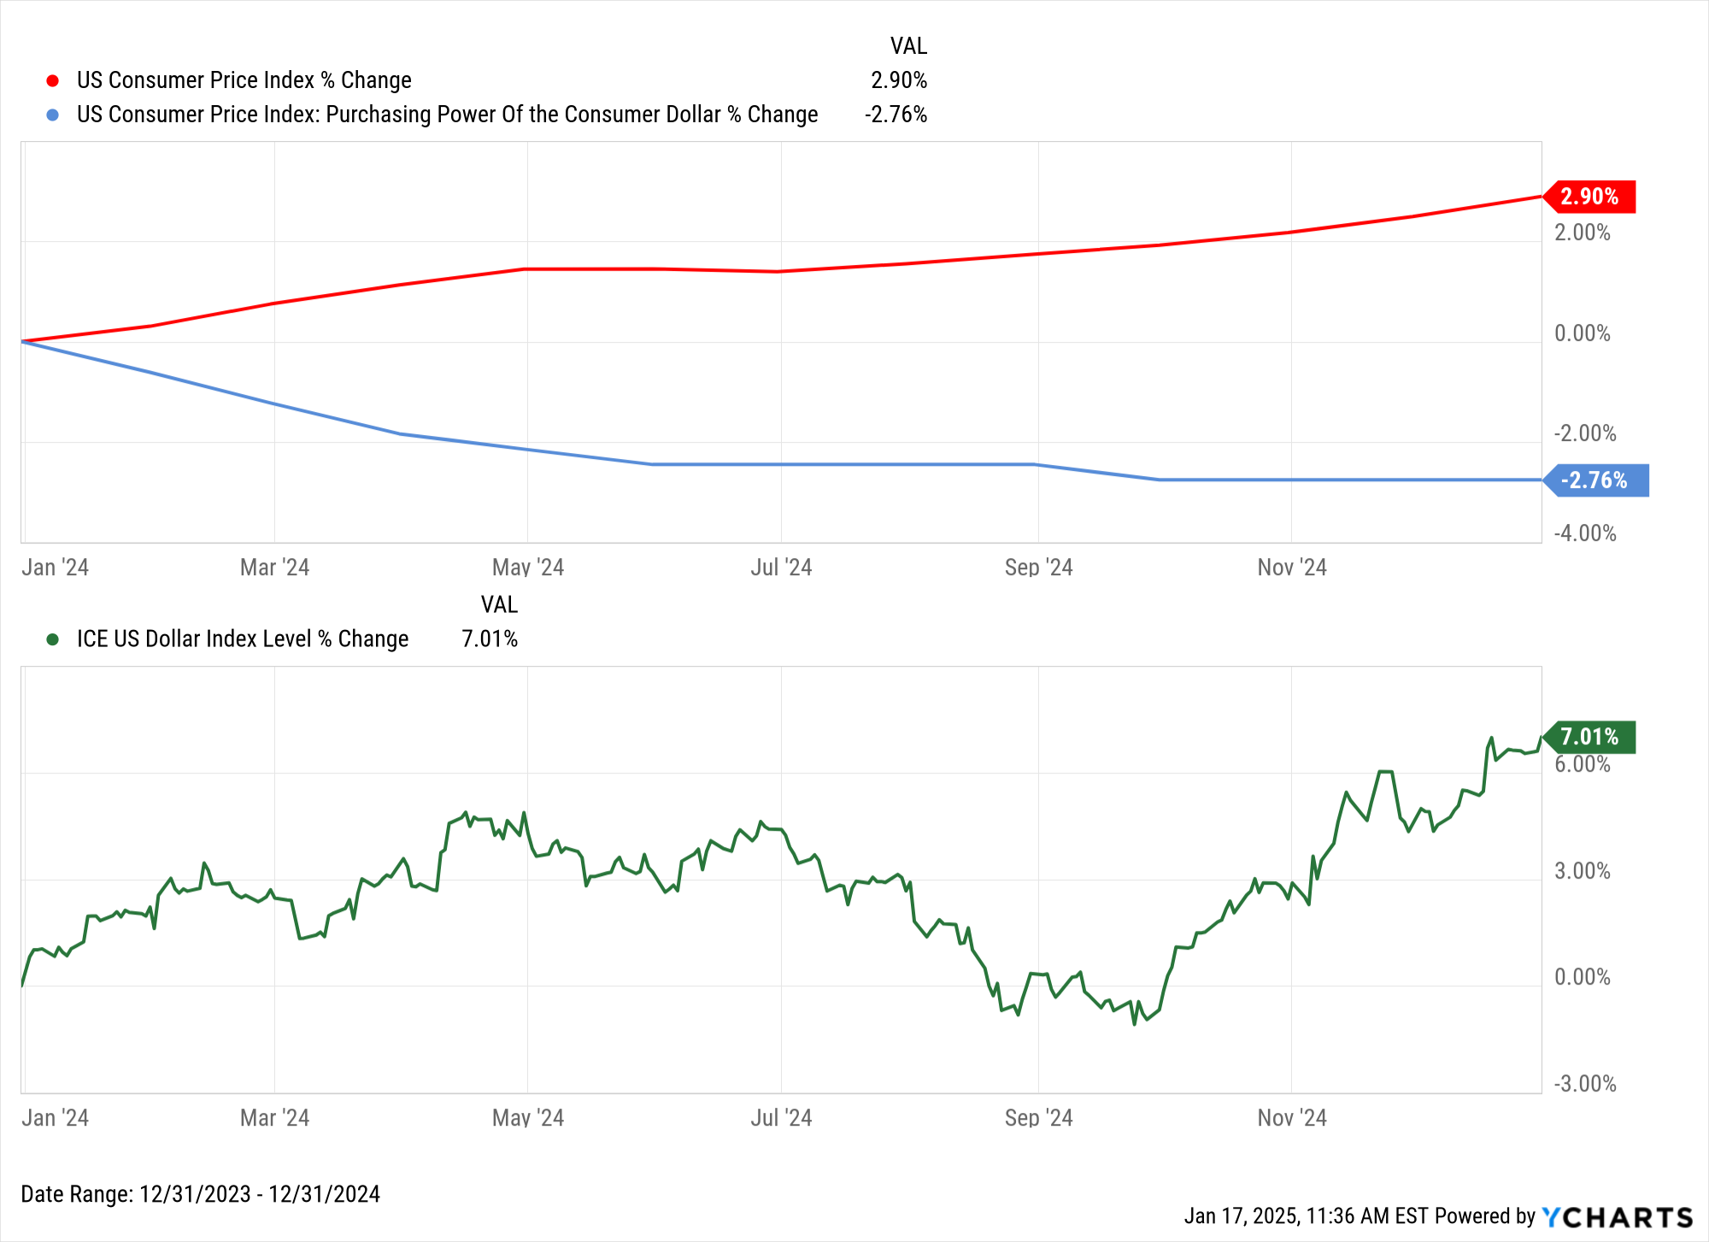
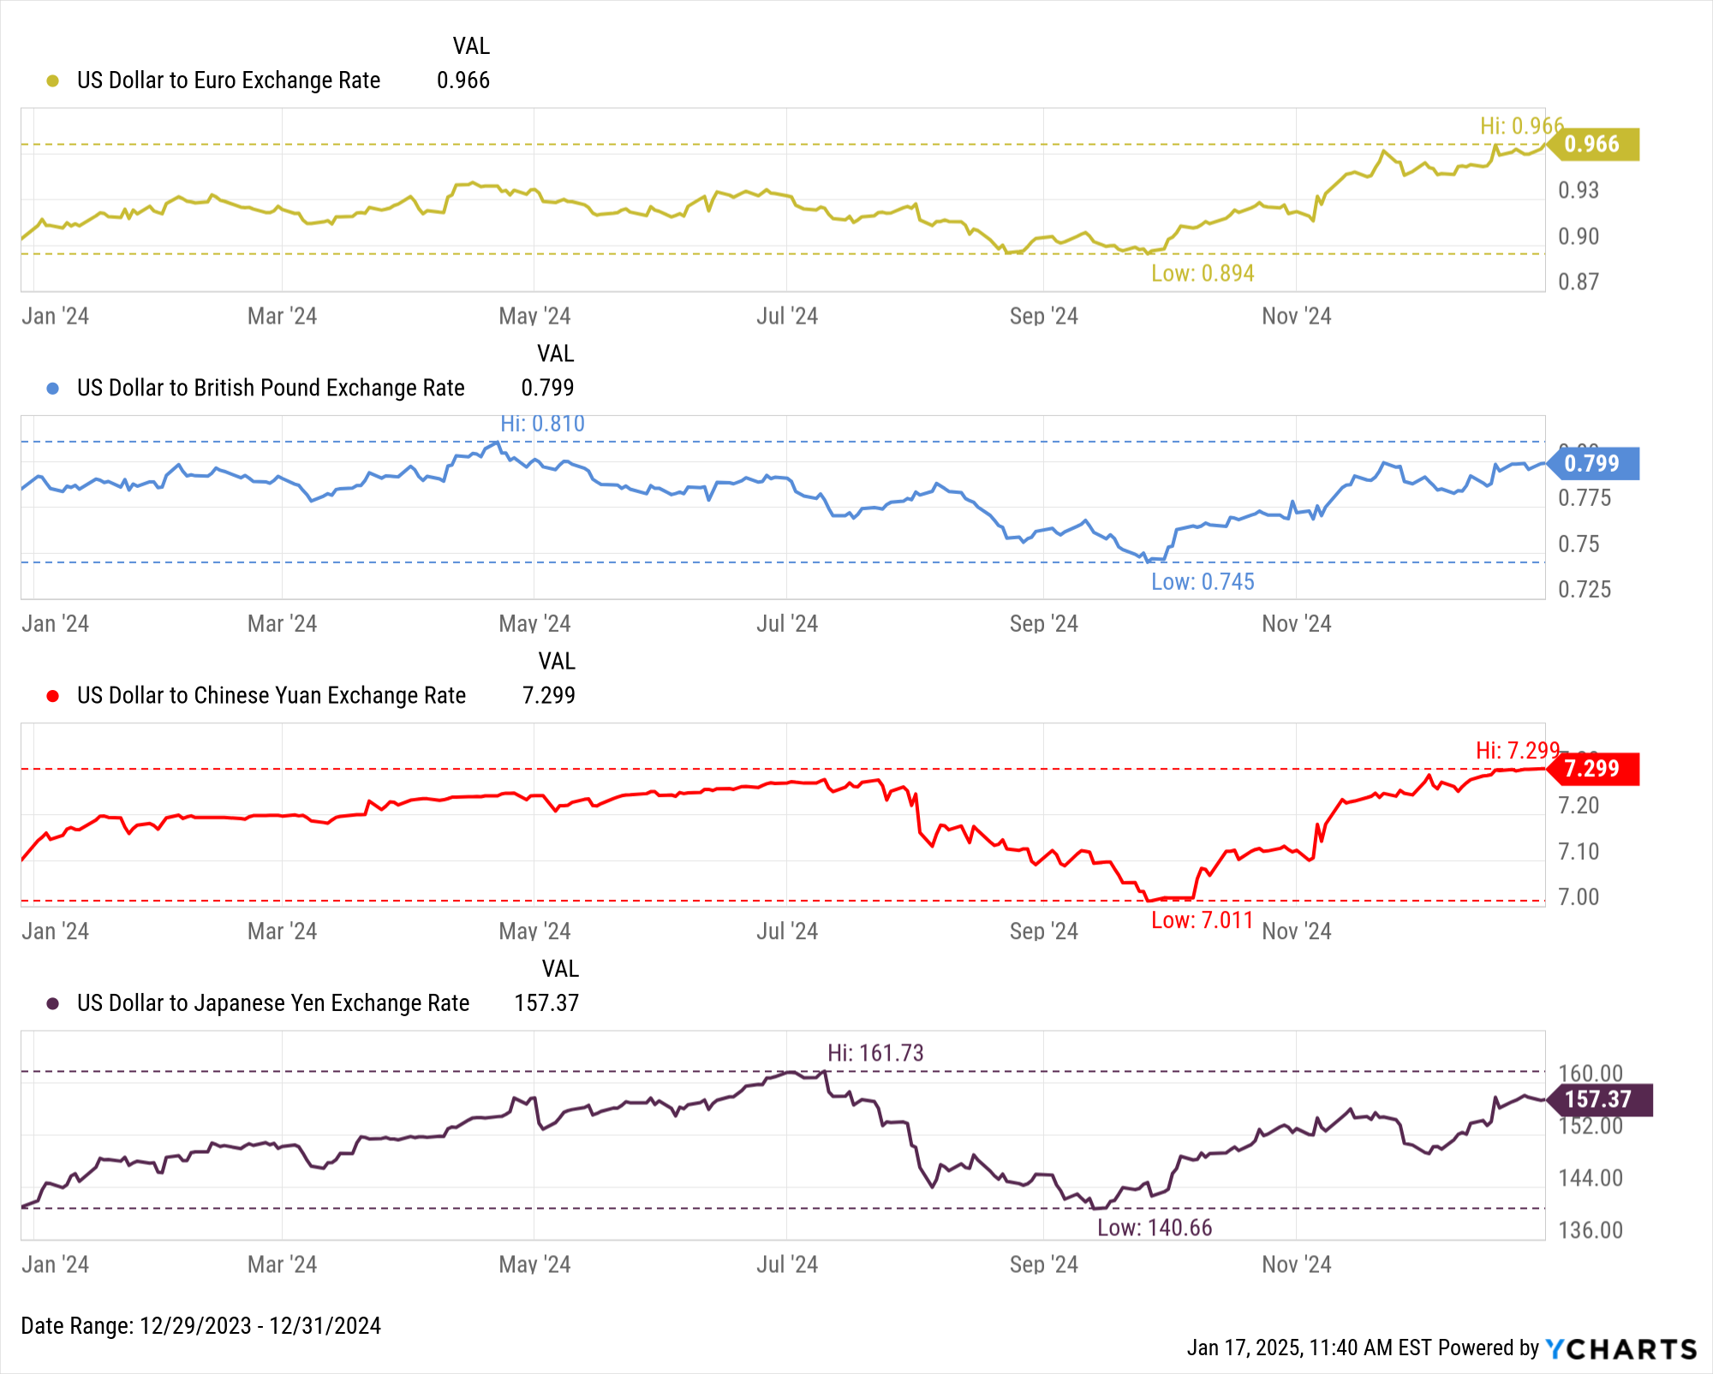
US Dollar Strength
Notes:
L: As of December 31st, 2024:
1Y US CPI % Change: 2.90%
1Y Purchasing Power of the Consumer Dollar % Change: -2.76%
1Y ICE US Dollar Index Level % Change: 7.01%
R: As of December 31st, 2024:
1 USD = 0.966 EUR (0.966 TTM high, 0.894 TTM low)
1 USD = 0.799 GBP (0.810 TTM high, 0.745 TTM low)
1 USD = 7.299 CNY (7.299 TTM high, 7.011 TTM low)
1 USD = 157.37 JPY (161.73 TTM high, 140.66 TTM low)

Slide 24
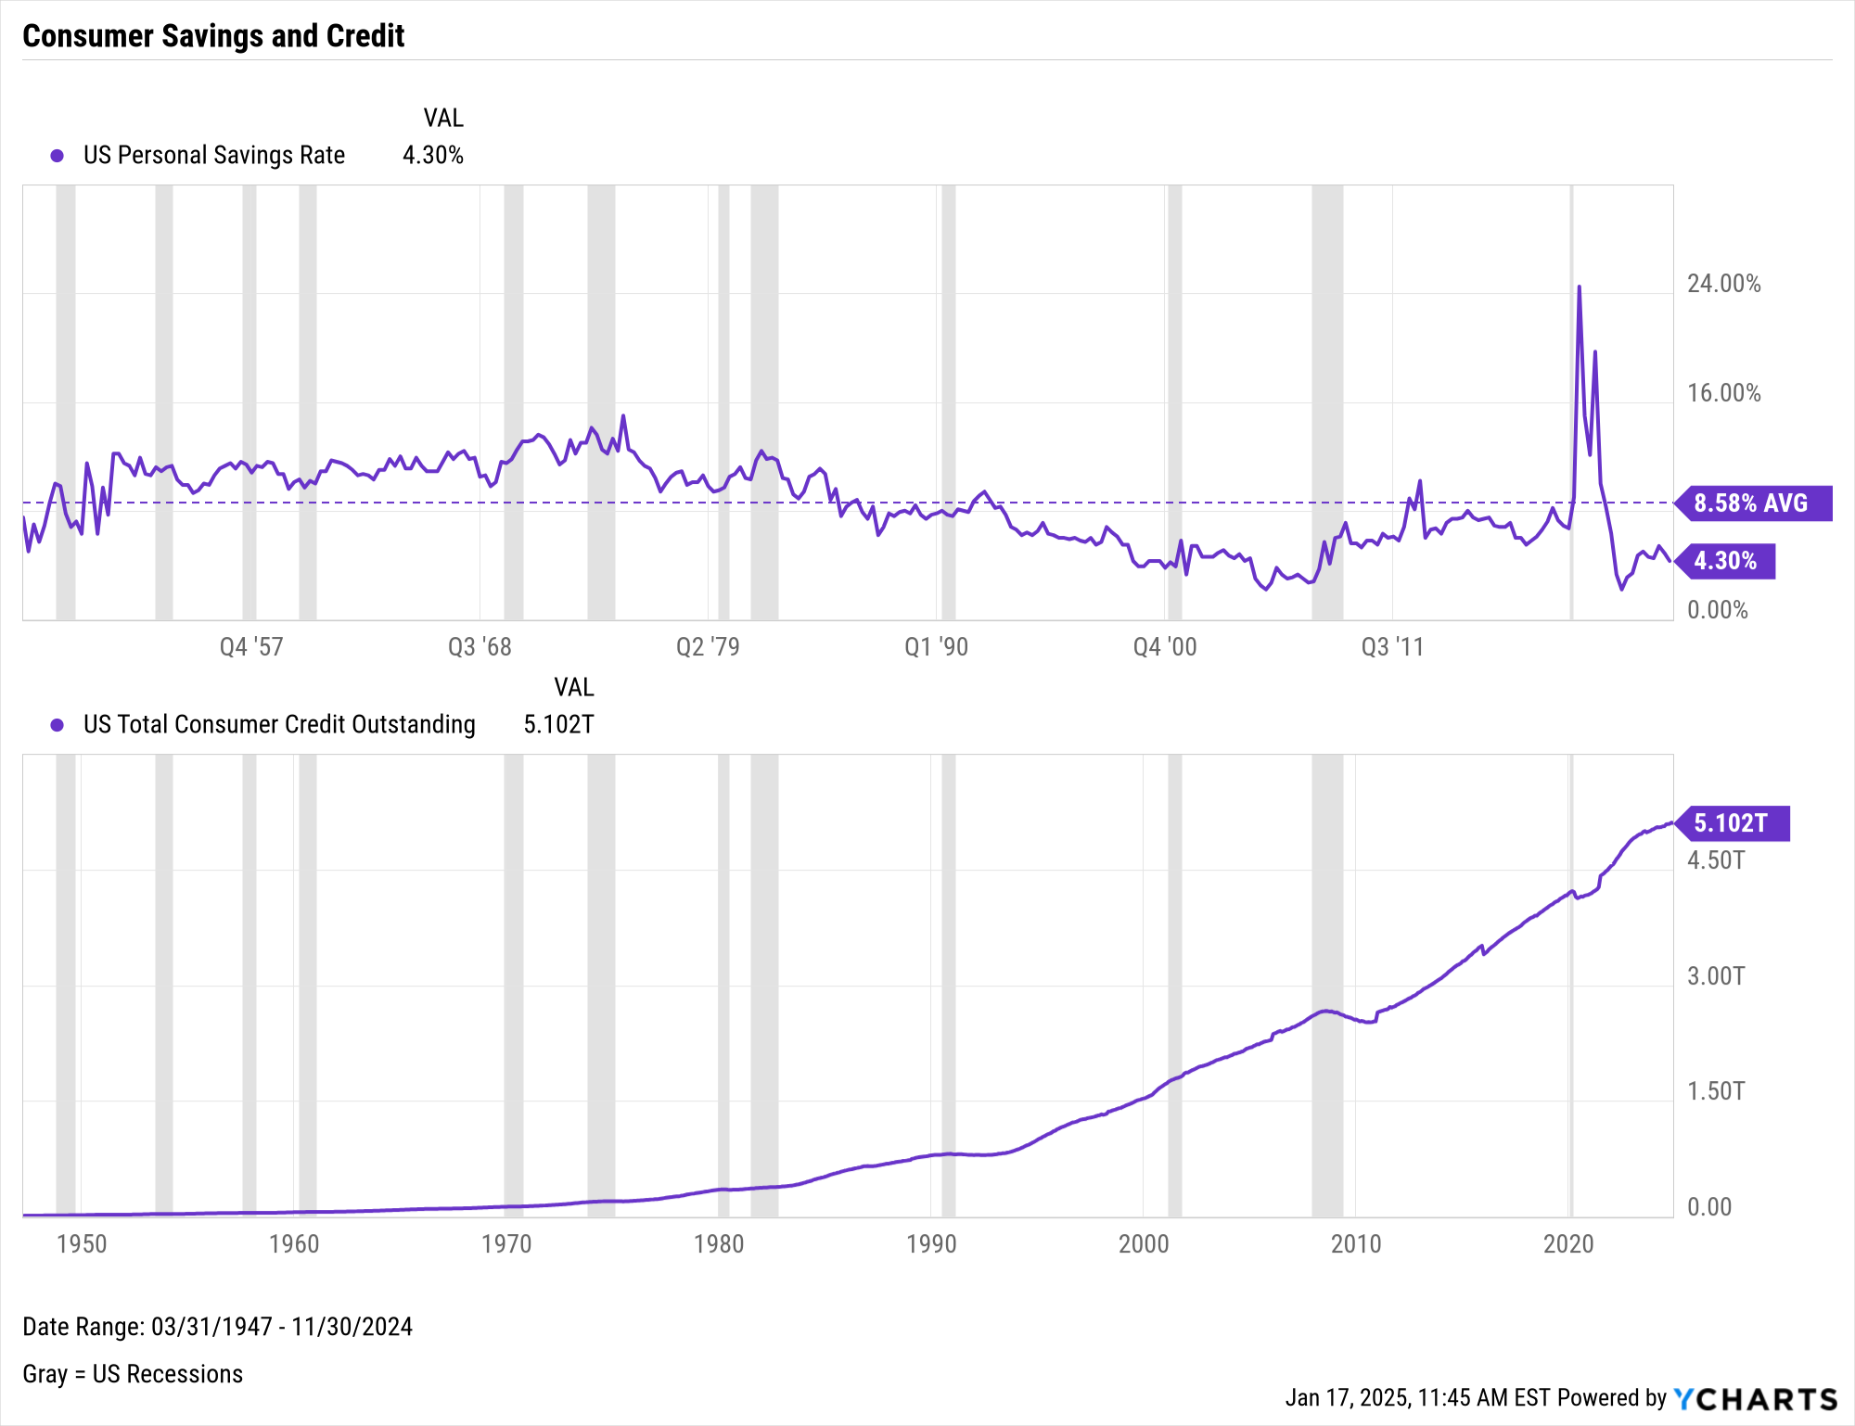
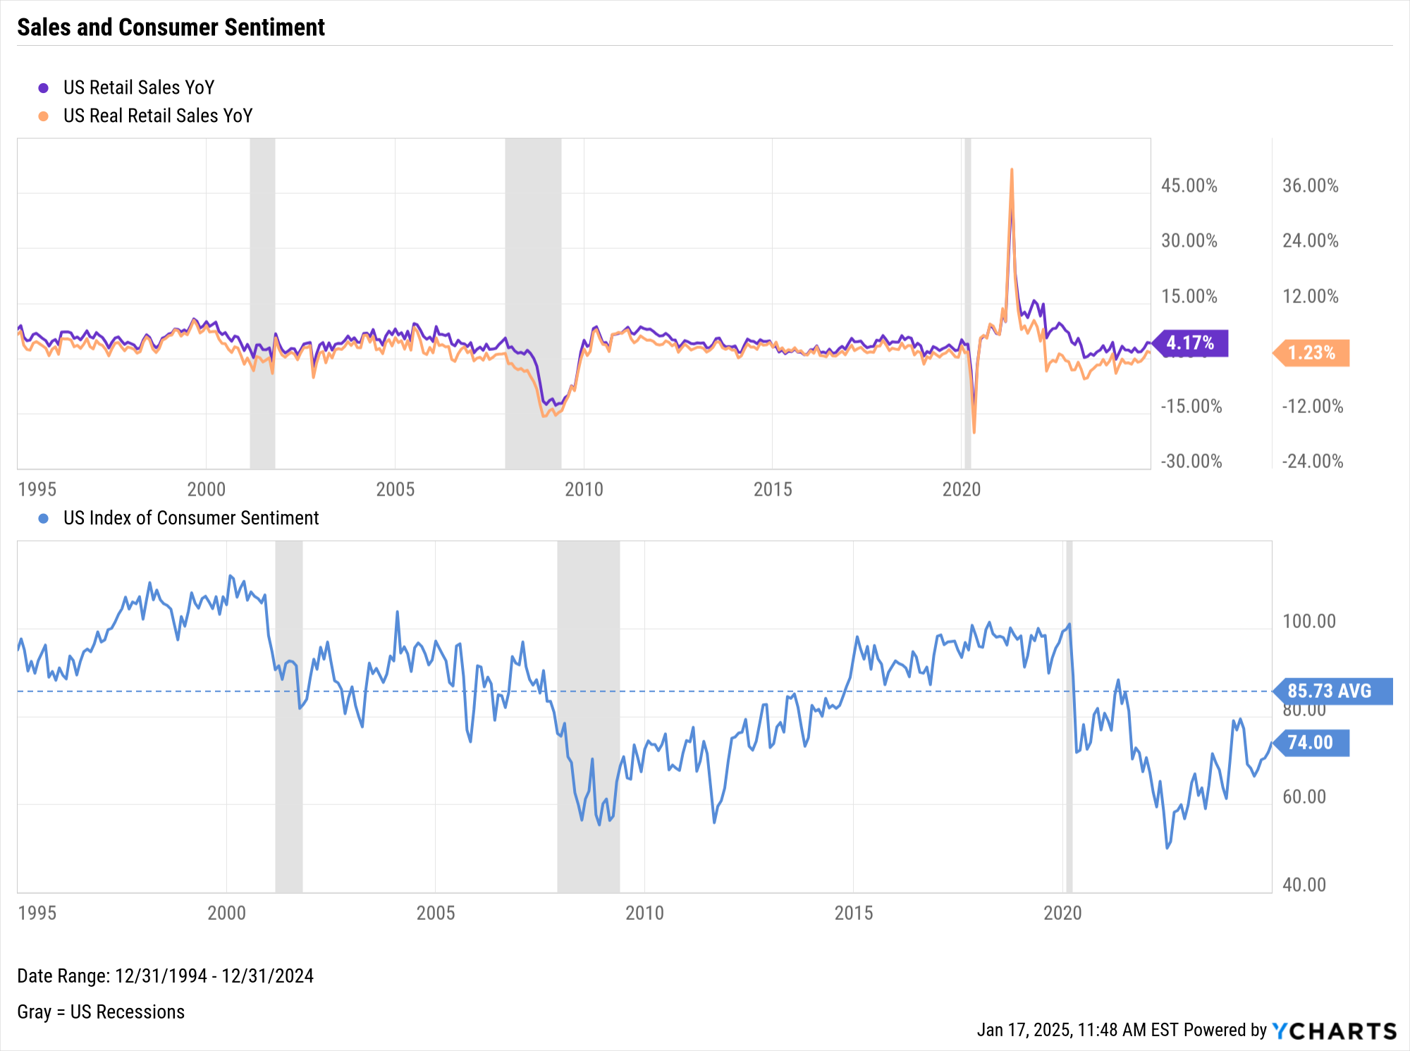
Consumers
Notes:
L: As of November 2024:
US Personal Savings Rate: 4.30% (Below historical average of 8.58%)
US Total Consumer Credit Outstanding: $5.102T
R: As of December 2024:
US Retail Sales YoY: 1.23%
US Real Retail Sales YoY: 4.17%
Spread: 2.94%
US Index of Consumer Sentiment: 74.00
+3.9 points QoQ, 11.73 points below 30-year average

Slide 25
Bonds & Interest Rates
Collection of Data Summarizing Moves in the Fixed Income Markets over the Last Quarter

Slide 26
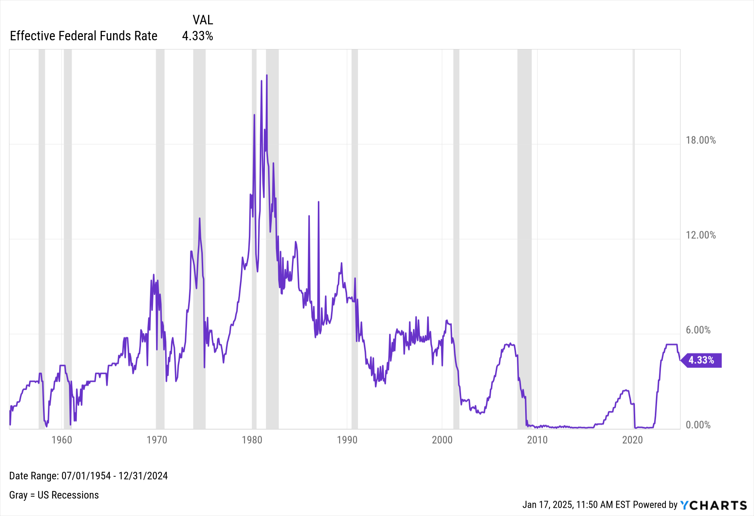
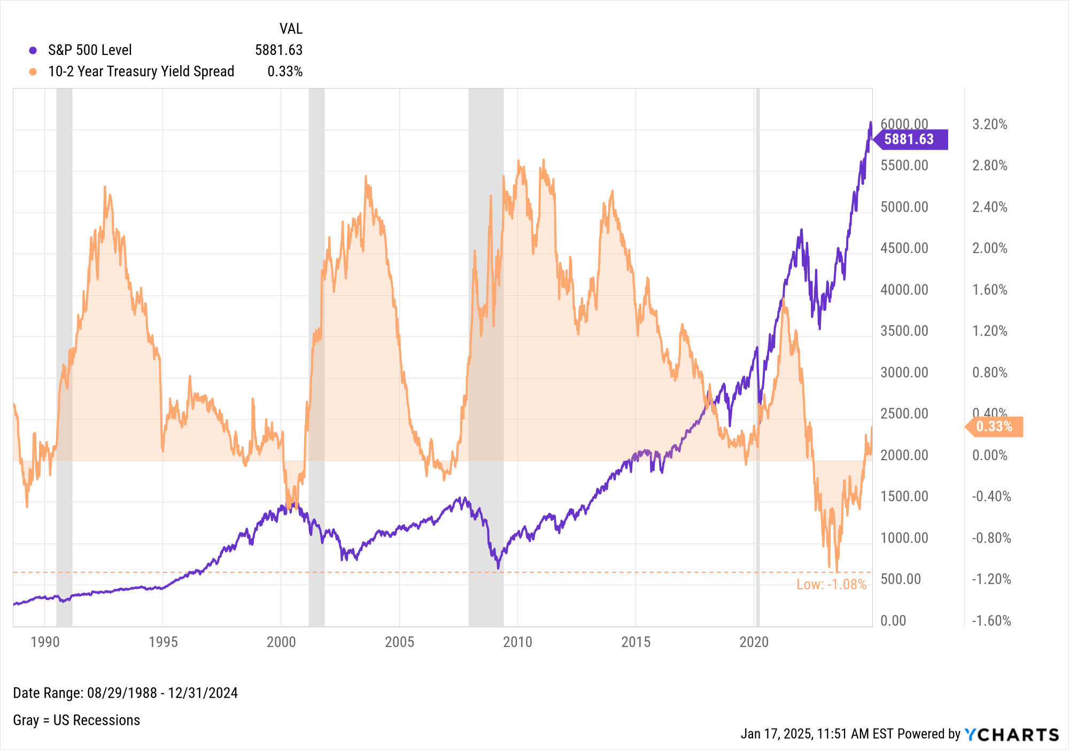
Interest Rates & Spreads
Notes:
L:
Effective Federal Funds Rate as of 12/31/2024: 4.33%
Current Target Upper Limit Fed Funds Rate: 4.50%
R: As of December 31st, 2024:
S&P 500 Level: 5881.63
10-2 Year Treasury Yield Spread: 0.33% (normalized on September 6th, 2024 after being inverted since July 6th, 2022)

Slide 27
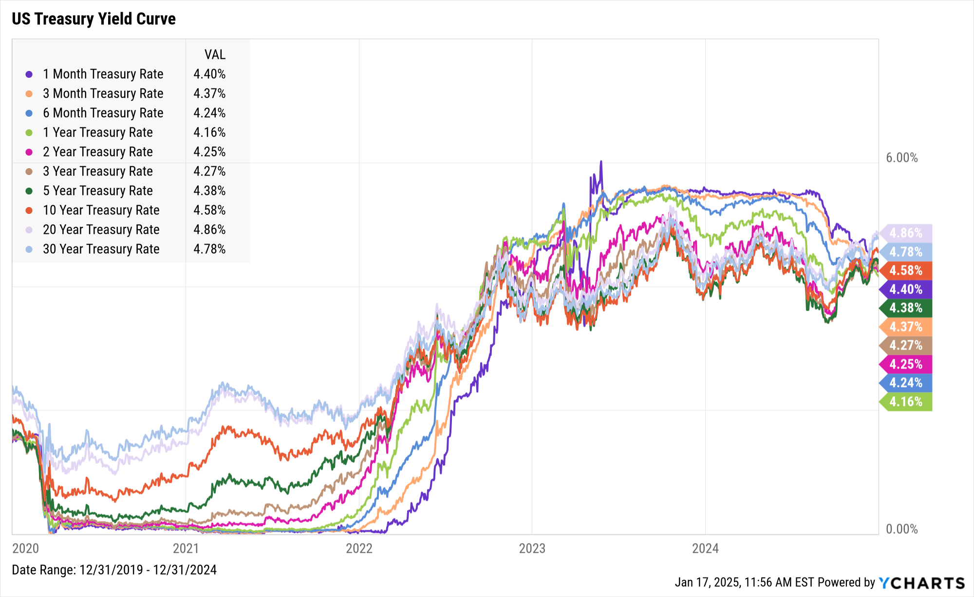
Treasury Yield Curve
Duration | Rate | QoQ Δ
1-Month | 4.40% | ▼ 53 bps
3-Month | 4.37% | ▼ 36 bps
6-Month | 4.24% | ▼ 14 bps
1-Year | 4.16% | ▲ 18 bps
2-Year | 4.25% | ▲ 59 bps
3-Year | 4.27% | ▲ 69 bps
5-Year | 4.38% | ▲ 80 bps
10-Year | 4.58% | ▲ 77 bps
20-Year | 4.86% | ▲ 67 bps
30-Year | 4.78% | ▲ 64 bps
Notes:
Duration: 12/31 9/30 QoQ ∆
1 Month 4.40% 4.93% -53 bps
3 Month 4.37% 4.73% -36 bps
6 Month 4.24% 4.38% -14 bps
1 Year Rate 4.16% 3.98% 18 bps
2 Year Rate 4.25% 3.66% 59 bps
3 Year Rate 4.27% 3.58% 69 bps
5 Year Rate 4.38% 3.58% 80 bps
10 Year 4.58% 3.81% 77 bps
20 Year 4.86% 4.19% 67 bps
30 Year 4.78% 4.14% 64 bps

Slide 28
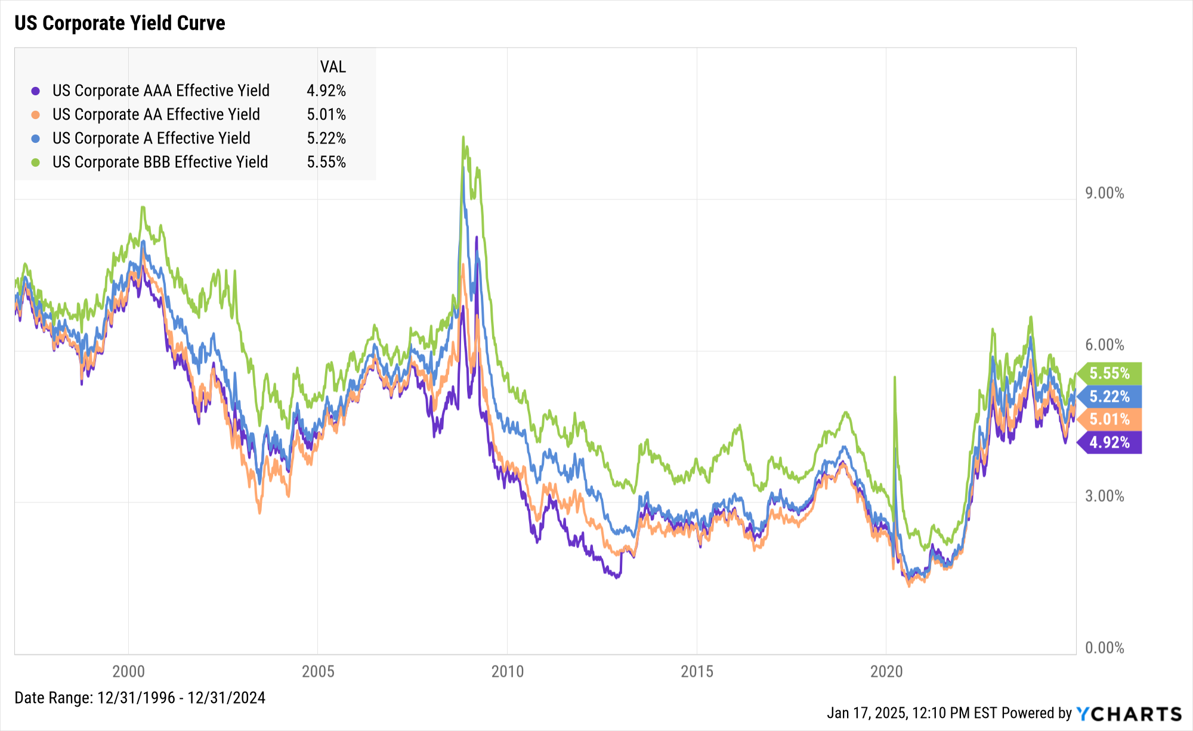
Corporate Yields
Type | Rate | QoQ Δ
AAA | 4.92% | ▲ 68 bps
AA | 5.01% | ▲ 64 bps
A | 5.22% | ▲ 59 bps
BBB | 5.55% | ▲ 58 bps
Notes:
Duration: 12/31 9/30 QoQ ∆
AAA Bond 4.92% 4.24% 68 bps
AA Bond 5.01% 4.37% 64 bps
A Bond 5.22% 4.63% 59 bps
BBB Bond 5.55% 4.97% 58 bps

Slide 29
Charts of the Moment
Visuals Depicting Trends that are Impacting the Markets and Investments

Slide 30
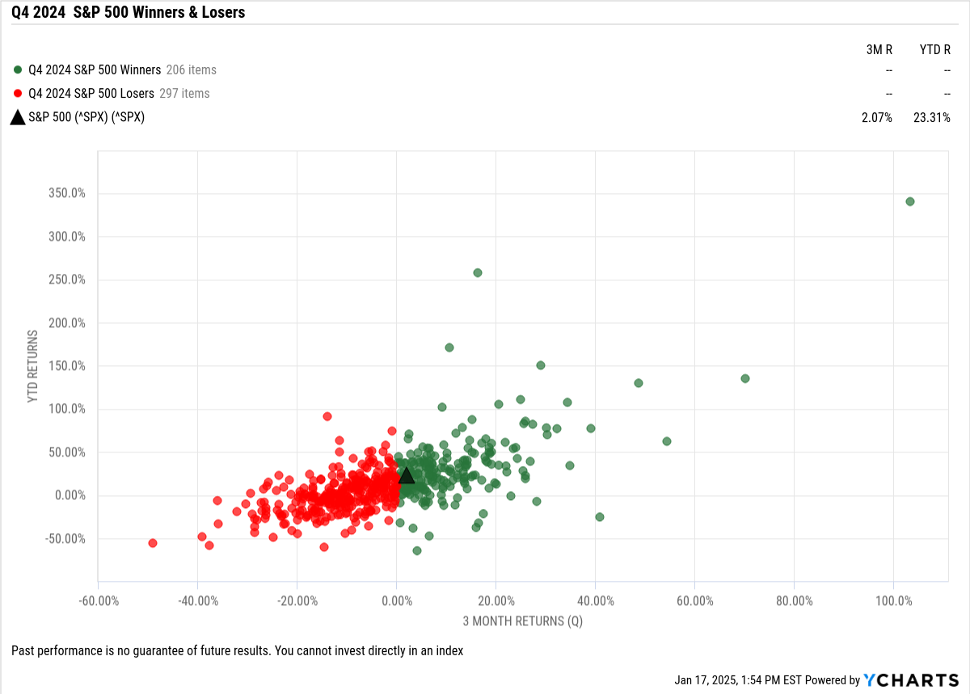
Q4 S&P 500 Winners & Losers
Notes:
297 S&P 500 constituents posted negative returns in Q4 (59% of the index), with the biggest loser being Celanese Corp (CE) which plummeted 49.1% in Q4. Palantir Technologies (PLTR) was the S&P 500’s biggest winner in Q4, surging 103.3% in the quarter.

Slide 31
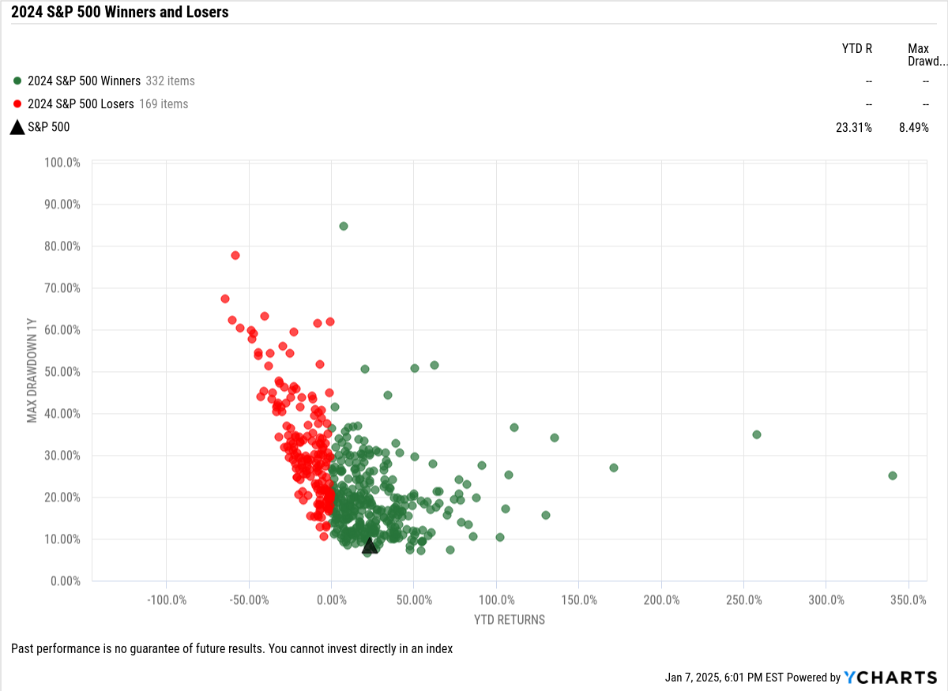
2024 S&P 500 Winners & Losers
Notes:
332 S&P 500 constituents posted positive returns in 2024 (66% of the index), with the biggest winner being Palantir Technologies (PLTR) which soared 340.5% in 2024.
For Winners & Losers of the Dow, Nasdaq, Russell 1000, and Russell 2000, check out our blog post on The Best Performing Stocks of 2024.

Slide 32
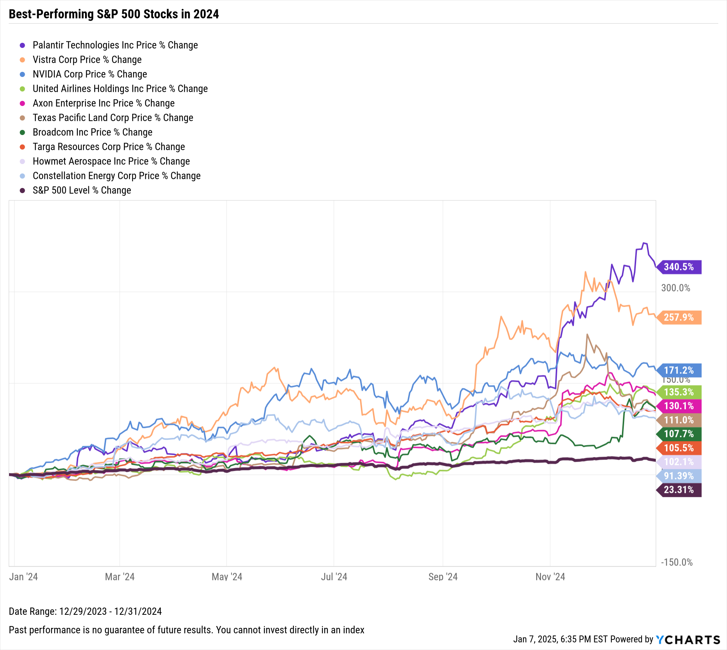
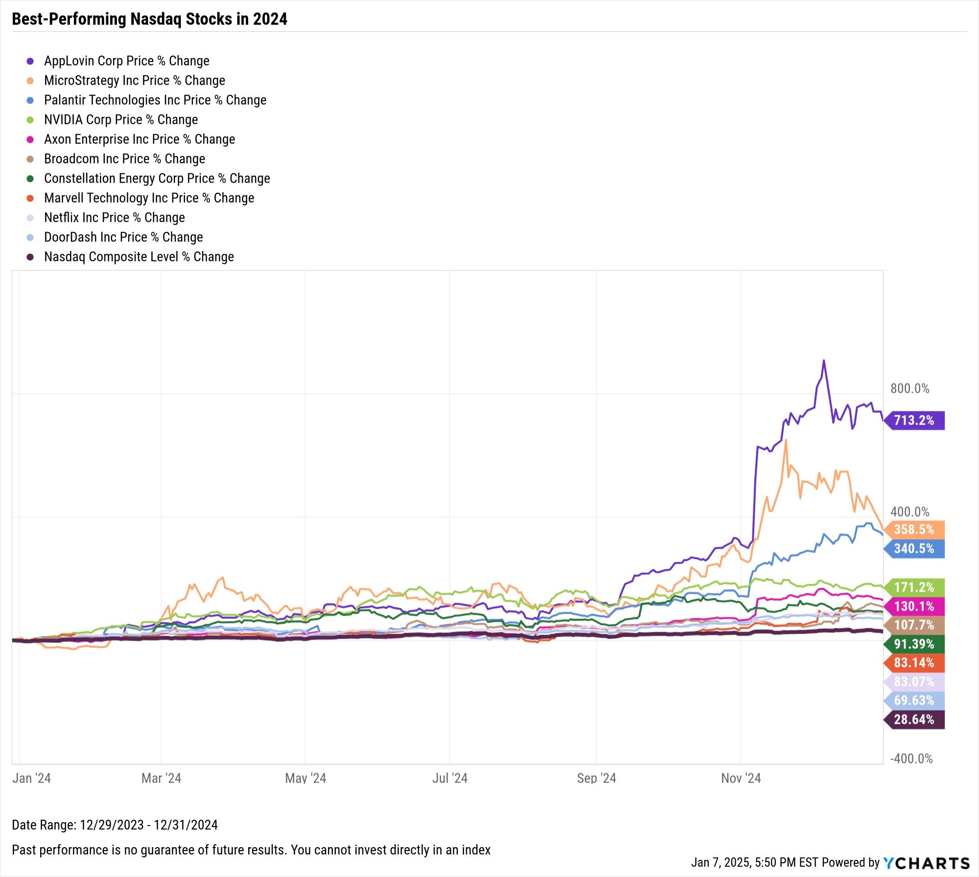
Best-Performing Stocks of 2024
Notes:
Best-performing S&P 500 stocks in 2024:
Palantir Technologies Inc (PLTR): 340.5%
Vistra Corp (VST): 257.9%
NVIDIA Corp (NVDA): 171.2%
United Airlines Holdings Inc (UAL): 135.3%
Axon Enterprise Inc (AXON): 130.1%
Texas Pacific Land Corp (TPL): 111.0%
Broadcom Inc (AVGO): 107.7%
Targa Resources Corp (TRGP): 105.5%
Howmet Aerospace Inc (HWM): 102.1%
Constellation Energy Corp (CEG): 91.4%
Best-performing NASDAQ stocks in 2024:
AppLovin Corp (APP): 713.2%
MicroStrategy Inc (MSTR): 358.5%
Palantir Technologies Inc (PLTR): 340.5%
NVIDIA Corp (NVDA): 171.2%
Axon Enterprise Inc (AXON): 130.1%
Broadcom Inc (AVGO): 107.7%
Constellation Energy Corp (CEG): 91.4%
Marvell Technology Inc (MRVL): 83.1%
Netflix Inc (NFLX): 83.1%
DoorDash Inc (DASH): 69.6%
For best-performing stocks in the Dow, Russell 1000, and Russell 2000, check out our blog post on The Best Performing Stocks of 2024.

Slide 33
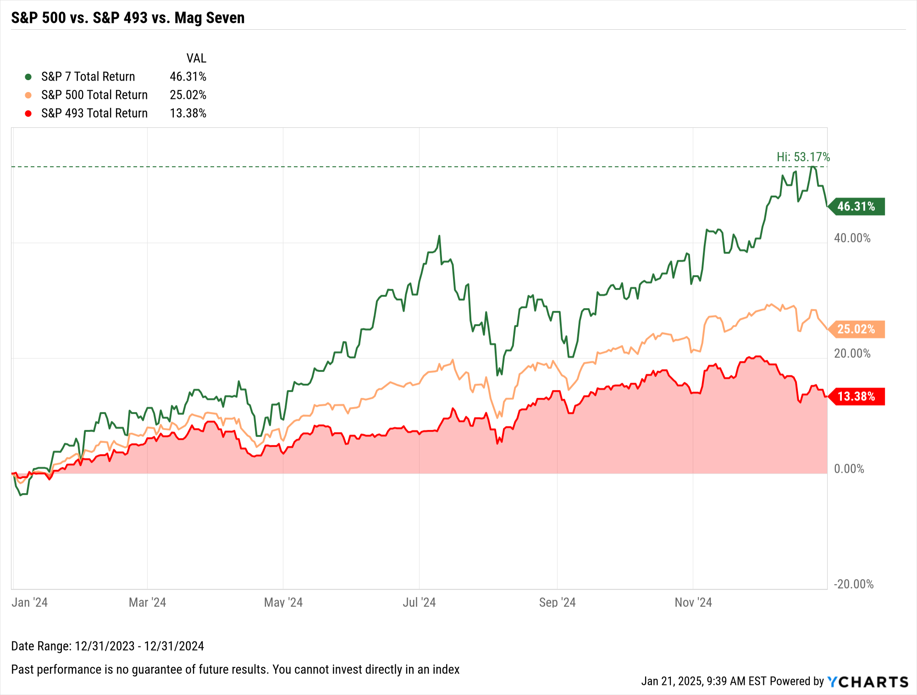
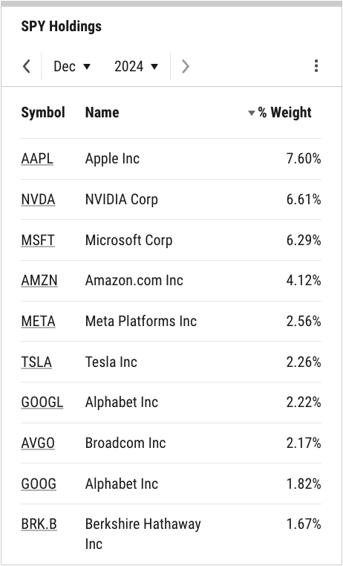
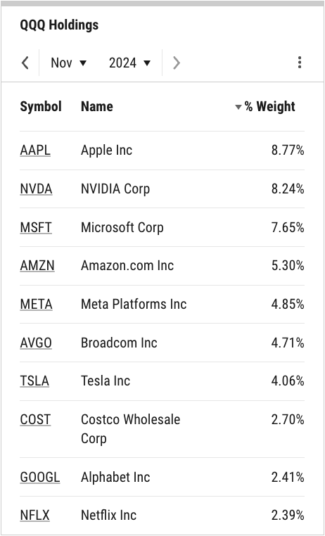

Index Concentration
SPY Top 10 Holdings
QQQ Top 10 Holdings
Top 10 = 37.32% of SPY
Top 10 = 51.08% of QQQ
Notes:
L: SPY’s Top 10 Holdings comprise 2.69 percentage points more of the S&P 500-tracking ETF QoQ; at 37.32%, this cohort makes up over a third of SPY in its entirety. Concentration in QQQ’s Top 10 Holdings grew by 0.2 percentage points QoQ, making up over half (51.08%) of the Nasdaq-indexed ETF.
R: The “Magnificent Seven”, sometimes referred to as the “S&P 7”, is comprised of Apple (AAPL), Amazon.com (AMZN), Alphabet (GOOG, GOOGL), Meta Platforms (META), Microsoft (MSFT), NVIDIA (NVDA), and Tesla (TSLA). The S&P 7 as a collective was up 10% in Q4 alone–and 46.3% in 2024–whereas the remaining constituents (the “S&P 493”) fell 1.9% as a whole in Q4.

Slide 34
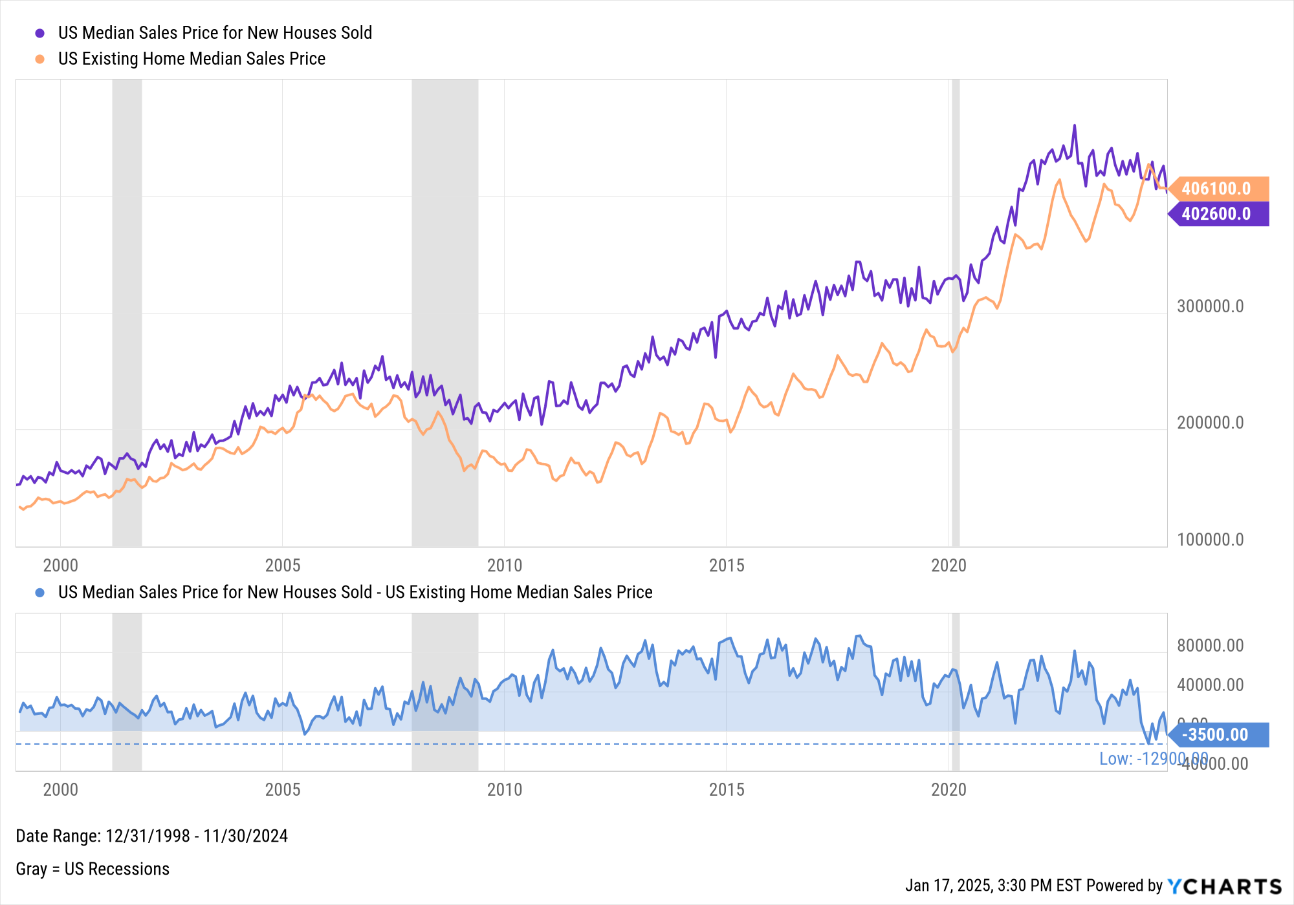
Existing Home Prices > New Home Prices
Notes:
In our Q2 2024 Economic Update Deck, we highlighted that the US median sales price for existing homes was more expensive than that for new homes for just the second time since December 1998 (the most historical data available for Existing Home Median Sales Prices). The only other time this occurrence took place was in June 2005, when existing home prices were $3,300 more expensive than new homes on a median basis.
The US median sales price for existing homes exceeded that of new homes four times in 2024:
May 2024: $2,900 higher median sales price for existing homes
June 2024: $12,900
August 2024: $8,400
November 2024: $3,500

Slide 35

Start a Free Trial
Book a Demo
YCharts is not registered with the U.S. Securities and Exchange Commission (or with the securities regulatory authority or
body of any state or any other jurisdiction) as an investment adviser, broker-dealer or in any other capacity, and does not purport
to provide investment advice or make investment recommendations by or through the Content found on the Site or otherwise. The
Site and the Content are provided for the sole purpose of enabling you to conduct investment research. Other uses of the Site and the Content are expressly prohibited. Full disclosure https://ycharts.com/about/disclosure

